Slide 1
Applications in Embedded Environment
Embedded Programming Workshop
March 8, 2016
Cosmin Stoica – Automotive OS Team SW ENGINEER

Slide 2
Info
Internet Access: Freescale Guest
  Username and Password available on papers
Workshop files:
  www.nxp.com/linuxembeddedchallenge
  http://www.nxp.com/linuxembeddedchallenge -> Categories -> Workshop Files

Slide 3
UDOO & ArduinO

Slide 4
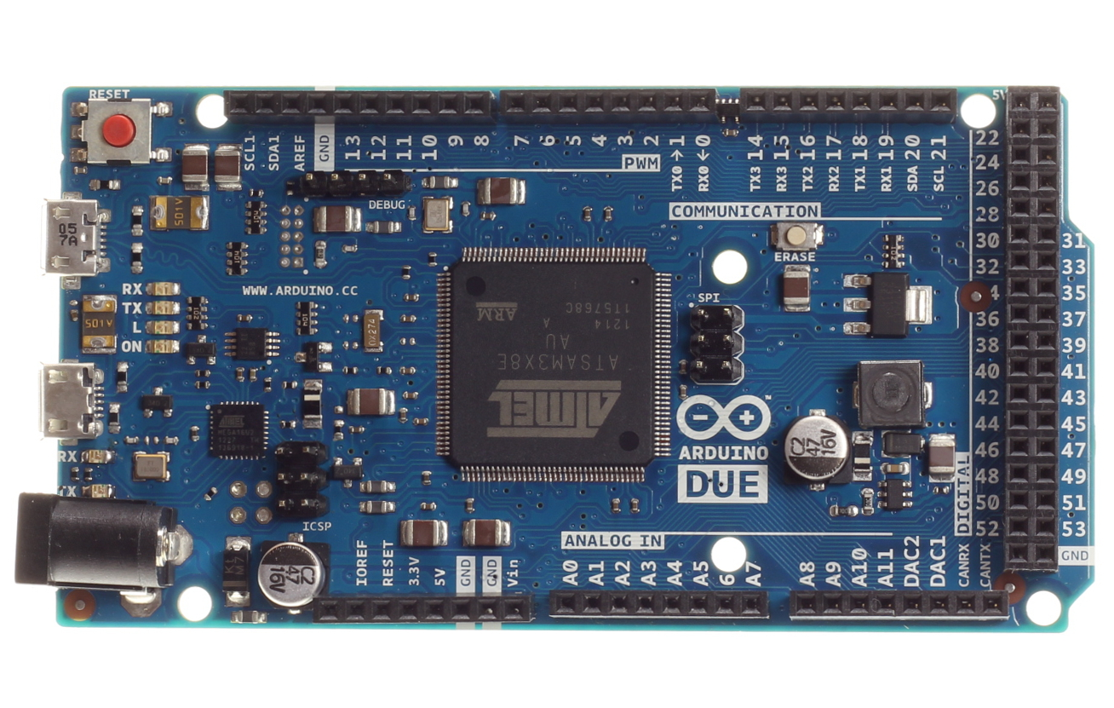
Arduino
Arduino is:
  Open-source physical computing platform
  Inexpensive
  Cross-platform
  Simple, clear programming environment
  Open source and extensible software
  Open source and extensible hardware

Slide 5
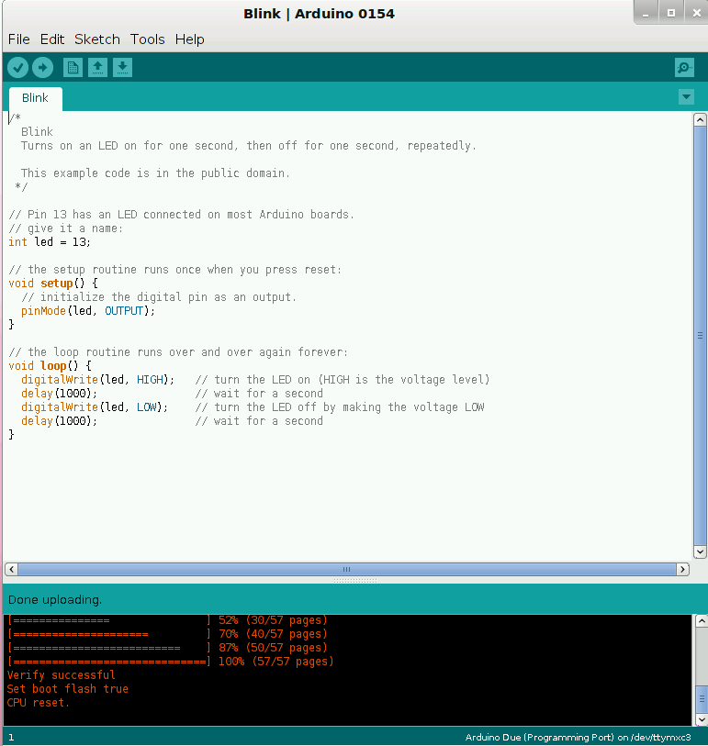
Arduino Sketch & Arduino IDE
Global Variables
Declare variables at top
setup()
Initialize
Reset Button Pressed
Running
loop()

Slide 6
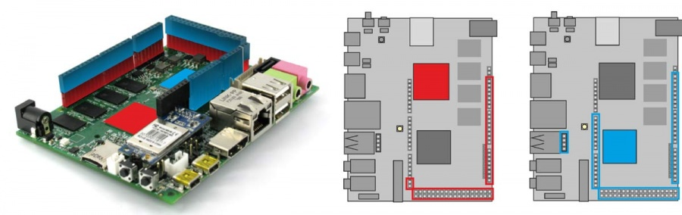
Arduino & UDOO

Slide 7
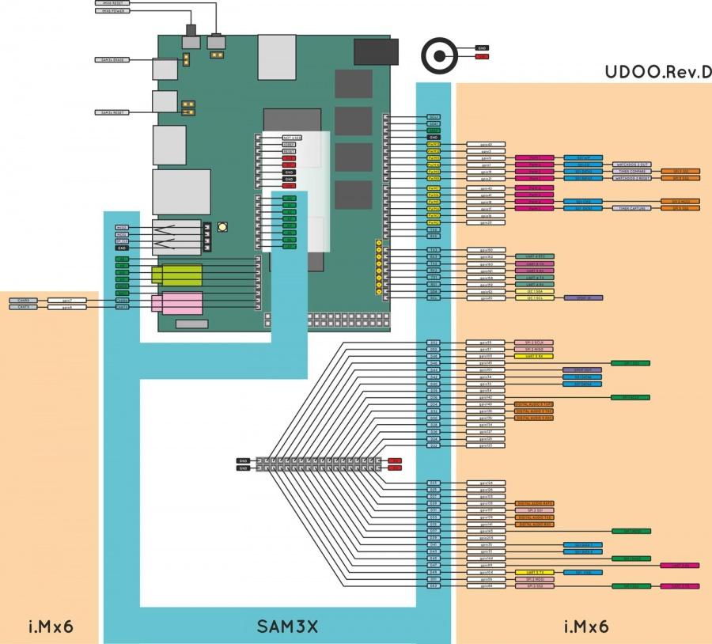
UDOO GPIO Pinout
most of the GPIOs available on
external pin headers shared by
I.MX and Atmel SAM3X8E
Pin mode:
  INPUT
  OUTPUT
Both processors can control all digital
external pins
Atmel SAM3X8E - Arduino applications
I.MX processor – Linux/Android
http://www.udoo.org/tutorial/linux-gpio-manipulation/

Slide 8
SAM3x8E GPI/Os management
Arduino Programming Language
Set the direction of pin (setup):
  pinMode(<pin_number>, INPUT);
  pinMode(<pin_number>, OUPUT);
Pin states:
  INPUT: digitalRead(<pin_number>)
  OUPUT: digitalWrite(<pin_number>, LOW/HIGH)
  Note: analogRead/analogWrite for PWM
  Details about Arduino Language

Slide 9
i.MX6 GPI/O Management
External PINS can be handled as:
  GPIO
  I2C, SPI, PWMs output, UART etc…
GPIO:
  managed by the kernel
  accessible using /sys/class/gpio
    direction (in/out)
    value (0/1)
cat /sys/class/gpio/gpioXX/direction
echo out/in > /sys/class/gpio/gpioXX/direction
cat /sys/class/gpio/gpioXX/value
echo 0/1 > /sys/class/gpio/gpioXX/value

Slide 10
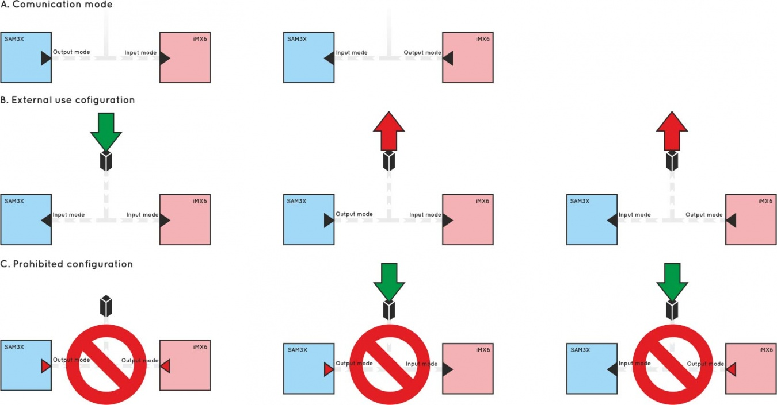
GPIOs Warnings
UDOO I/O pins are 3.3V only compliant!

Slide 11
Programming LED Blink on Arduino IDE
Open Arduino IDE
  setup() and loop ()
API:
  delay
  pinMode
  digitalWrite
  digitalRead
Connect the LED
  Shorter leg to ground
  Longer leg to PIN13
TODO: Blink the LED
Extra: Vary the brightness of the LED

Slide 12
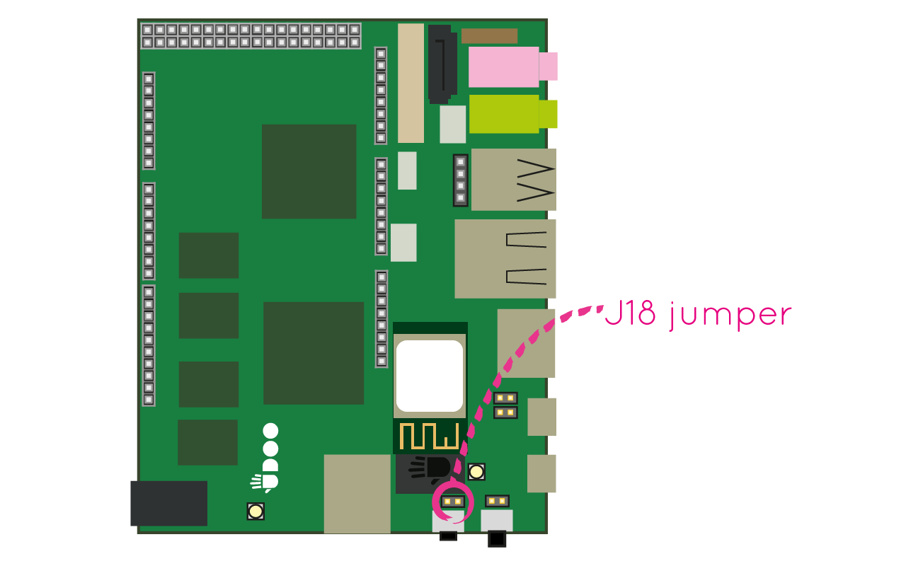
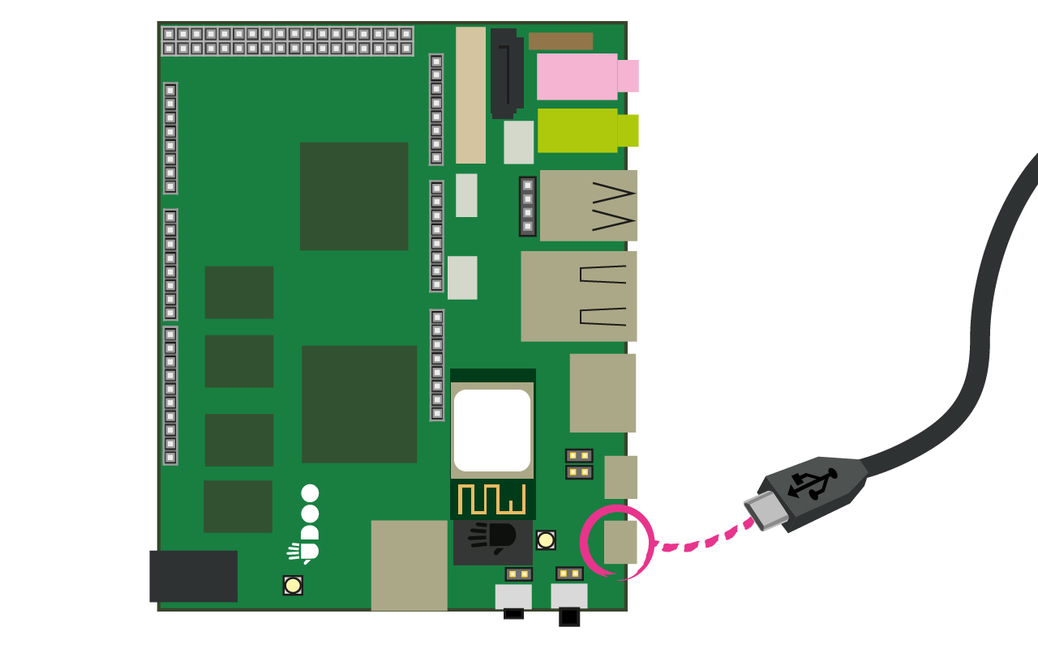
Programming UDOO Arduino Processor from External PC
A working SD Card
Close the serial monitor
J18 jumper should be unplugged.
Serial cable has to be connected to CN6
Allow the communication between PC and
the programming port of the SAM3X

Slide 13
Programming Arduino Processor from UDOO itself
Install Arduino 1.5.x on UDOO Ubuntu
J18 jumper should be plugged
Write the Arduino code
Upload the Arduino code

Slide 14
i.MX6 & ATMEL

Slide 15
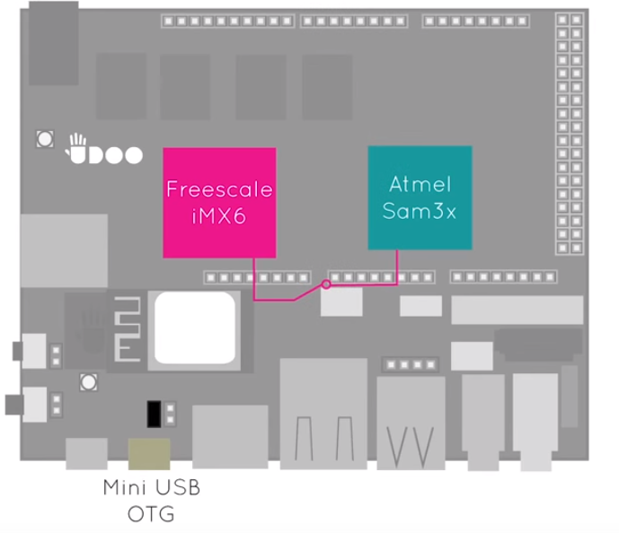
Communication between I.MX6 & ATMEL SAM3X
/dev/ttymxc3

Slide 16
Unidirectional communication from i.MX6 to Atmel Sam3x
Step1 – Serial Program for i.MX6
  Copy c_serial_example.c on UDOO rootfs
  Compile the application
    gcc c_serial_example.c –o c_serial_example
Step 2 – Create an Arduino project
  Remove the jumper J18
  Copy arduino_serial_example.ino on your host
  Create an Arduino project using Arduino IDE
  Compile & Upload the code
  Power off
  Put the jumper J18
Step 3 – Communication is ready
  Run ./c_serial_example

Slide 17
Bidirectional communication i.MX6 ←→ Atmel Sam3x(I)
Step 1 – Update the Arduino Application(arduino_serial_example.ino)
  Reply to Linux Messages with various messages
    Serial.print
    Serial.println
Step2 – Update the Linux application (c_serial_example.c)
  Read the characters sent by Arduino and print
    read
Step 3 – Communication is ready
  Run ./c_serial_example
  Extra:
  Linux APP:
    Send commands to Arduino to switch off/on the in a given interval
      write

Slide 18
UDOO Linux BSP

Slide 19

Motivation
Linux is everywhere:
  800k phones, 700k TVs activated daily
  Google, Twitter, Facebook, Amazon
  9 out of 10 of the world's super computer
Open source
Top-notch programmers

Slide 20

Linux Development Model
Open source:
  Competing companies work together: RedHat, IBM, Intel, Oracle, Nokia, HP, Google, etc.
Development model:
  Development cycle: 3 – 4 months
  Merge window: 2 weeks
Git trees:
  Official: Linus Torvalds
    git://git.kernel.org/pub/scm/linux/kernel/git/torvalds/linux-2.6.git
  Each important subsystem is maintained by a person
Notes:
Notes:
http://kernelnewbies.org/UpstreamMerge

Slide 21
General Architecture and Memory Layout

Slide 22
General Architecture and Memory Layout
User Applications
3GB Virtual Memory
User Space
System API
1GB Virtual Memory
Core Kernel Device Drivers
Kernel Space
Hardware

Slide 23


Kernel Space
Kernel Space

Slide 24
User Space Interface
User and kernel modes have different privilege levels
Kernel Trap
Types: exceptions (divide error/page fault), syscalls.
Source: user, cpu, external interrupt
Handler: exception/interrupt table
Files
e.g. sysfs, debugfs, device files
System API
User
Traps , Faults, System Calls
Core Kernel Device Drivers
Kernel

Slide 25
Hardware Interface
Core Kernel Device Drivers
Hardware Interrupts
Memory-mapped I/O (/proc/iomem)
- same address space for memory and I/O
- request_mem_region, ioremap
Ports, Memory Mapped I/O, Interrupts
Hardware

Slide 26
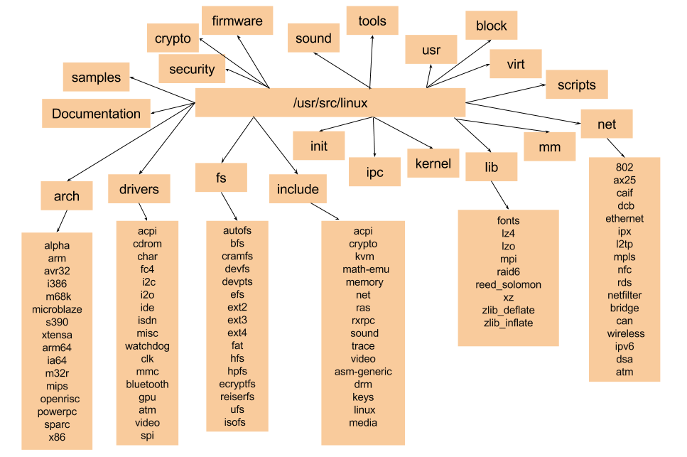
Folder Structure
lxr.free-electrons.com

Slide 27

Linux BSP and Configuration

Slide 28
Linux
BSP
Device Drivers
U-Boot
User’s
Apps
Linux Kernel
RFS

Slide 29
U-Boot
What is U-Boot?
  universal bootloader
  open source firmware for hardware platforms
  a boot loader widely used in embedded space
      What does it do?
  brings the board to a sane state out of reset
  loads OS image onto board and starts OS
Starts Kernel
Begins command interpreter
Initializes higher level devices :
Ethernet, SDHC, etc.
Continues execution in RAM
Relocates itself to RAM
Initializes DDR
Checks info on version numbers, clocks
and displays on screen
Initializes UART
Begins execution in SRAM
Reset vector points to SRAM

Slide 30
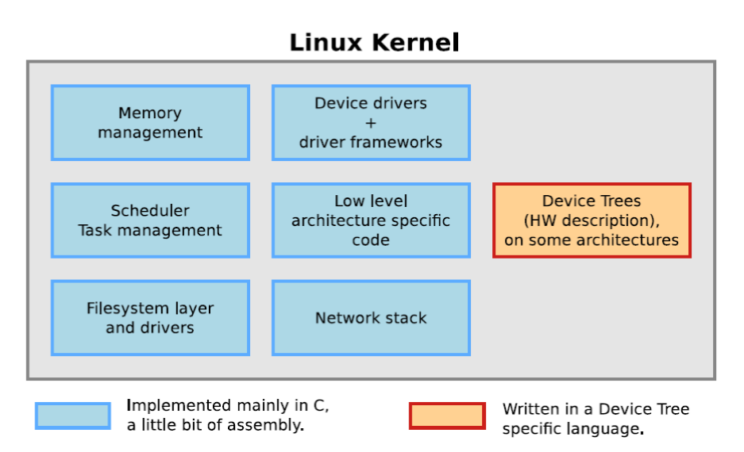

Slide 31
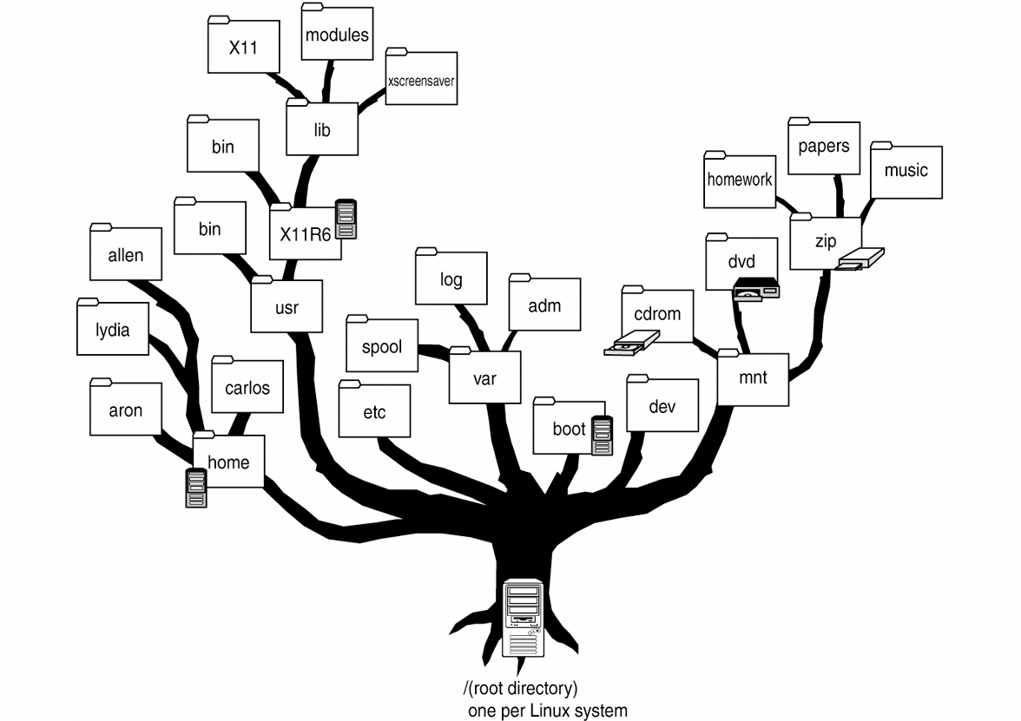
Root File System
The basic file system structure
Minimum set of directories: /dev, /proc, /bin, /etc, /lib, /usr, /tmp
Basic set of utilities: sh, ls, cp, mv, etc.
Minimum set of config files: rc, inittab, fstab, etc.
Runtime library to provide basic functions used by utilities

Slide 32
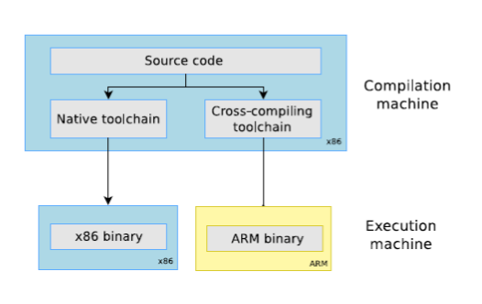
Cross-Compiling

Slide 33
U-boot Configuration
Load the Uboot UDOO configuration
make ARCH=arm CROSS_COMPILE=arm-linux-gnueabi- udoo_dl_config/udoo_quad_config
Compile the uboot
make ARCH=arm CROSS_COMPILE=arm-linux-gnueabi-
u-boot: uboot elf.
u-boot.imx: binary file with platform header.
System.map: symbol table file
Write the u-boot on the sd
sudo dd if=u-boot.imx of=/dev/<MICROSD_DEVICE_NAME> bs=512 seek=2

Slide 34
Linux Kernel Configuration
Load the Kernel UDOO configuration
make ARCH=arm CROSS_COMPILE=arm-linux-gnueabi- UDOO_defconfig
Modify default configuration
make ARCH=arm CROSS_COMPILE=arm-linux-gnueabi- menuconfig
Compile the kernel
make ARCH=arm CROSS_COMPILE=arm-linux-gnueabi-
Device Tree Blob (.dtb) - only on Kernel 3.10 versions
vmlinux: kernel image with symbols
zImage: compressed and stripped kernel image
System.map: symbol table file

