Slide 1
Internet of things (IoT)
Embedded Programming Workshop
March 11, 2016
Mihaela Panescu
Cosmin Stoica

Slide 2
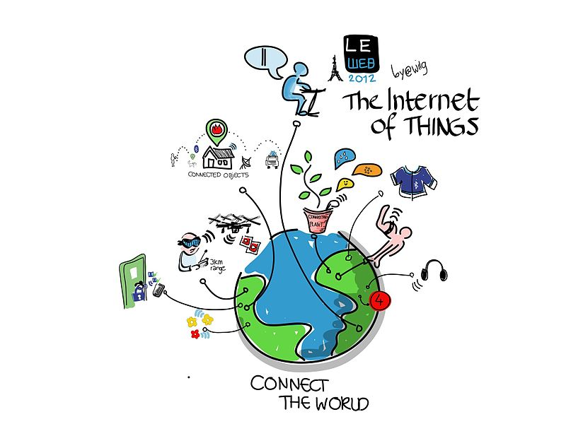
Content
  IoT Definition
  IoT Devices
  Basic Equipment
  Benefits and Risks
  Remote Blinking Control

Slide 3

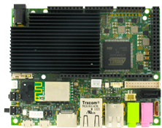

IoT Definition
Thing
Intelligence
Network

Slide 4
IoT Devices
Industrial
  Smart parking
  Smart vending machines
  Smart farms
Consumer
  Smart lighting
  Smart cities
Connected Appliances and Cars
  Refrigerator
  Washing machines
Wearable Devices
  Smart watches
  Smart glasses
  Fitness bands
  Medical wearables

Slide 5

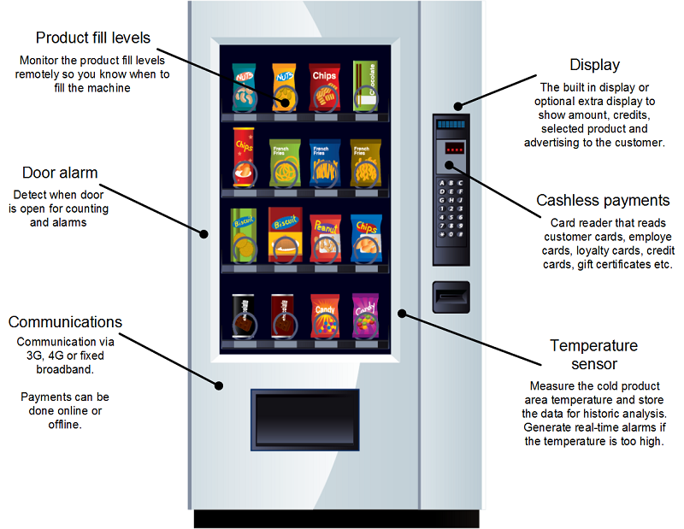
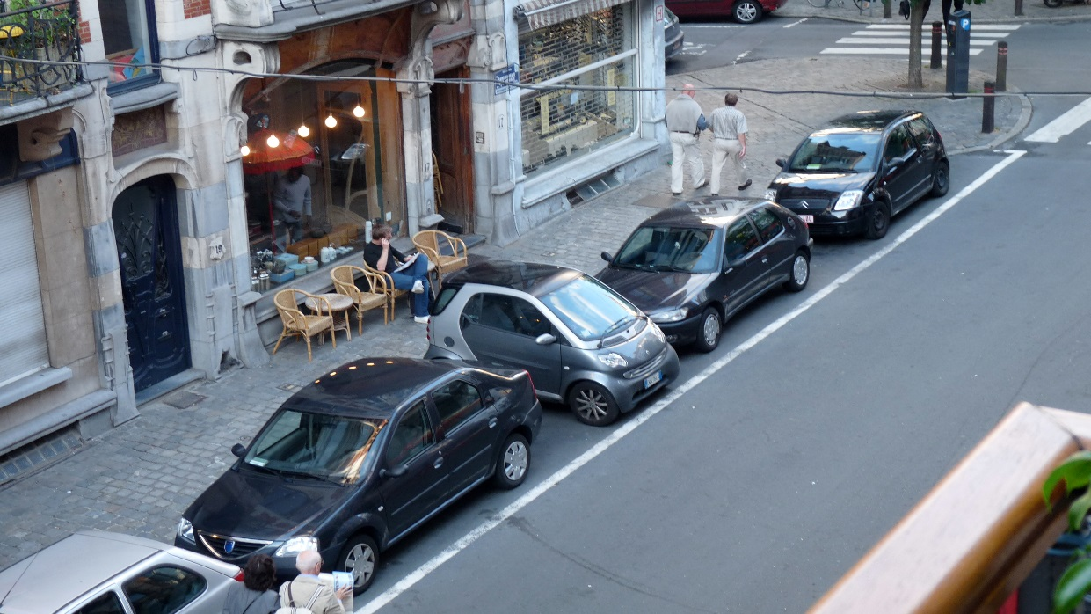
IoT Devices - Industrial
Smart vending machines
Smart farms
Smart parking

Slide 6
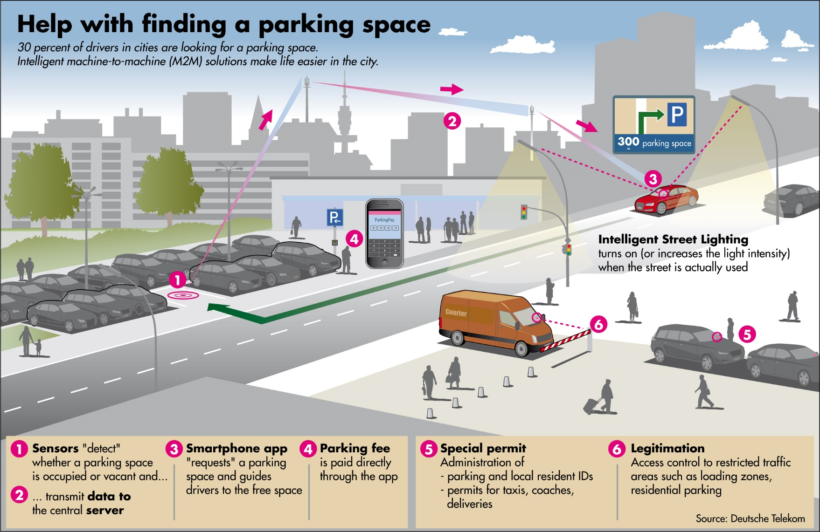
IoT Devices – Smart Parking

Slide 7
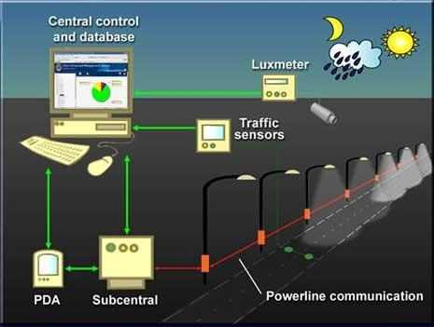
IoT Devices - Consumer
Smart lighting
Smart cities

Slide 8
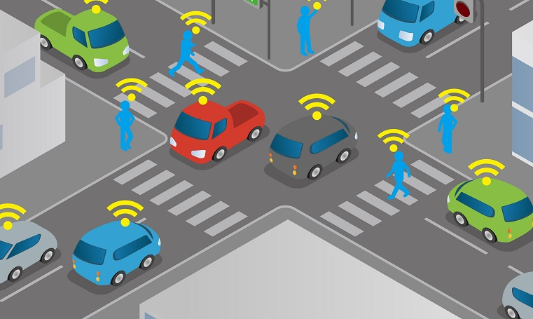
IoT Devices - Connected Cars

Slide 9
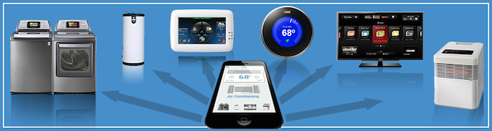
IoT Devices - Connected Appliances
Refrigerator
Washing machines

Slide 10
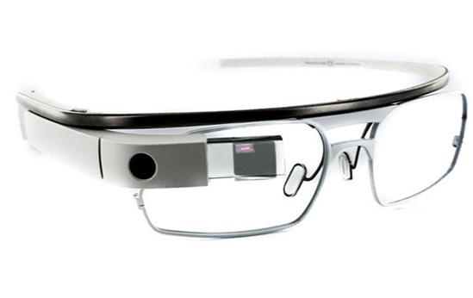
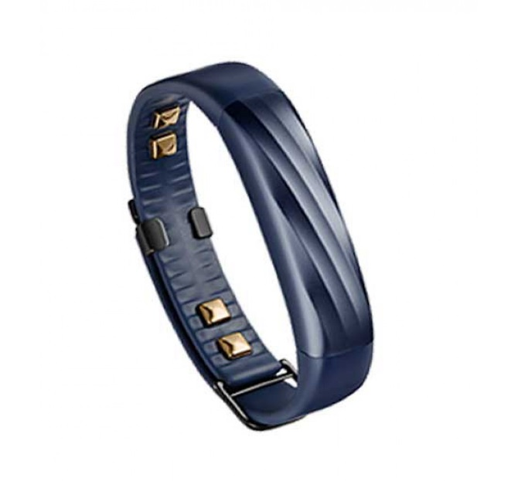
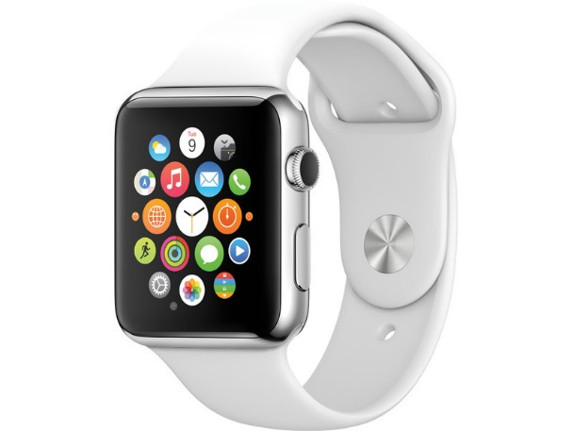
IoT Devices - Wearable Devices
Smart watches
Smart glasses
Fitness bands
Medical wearables

Slide 11
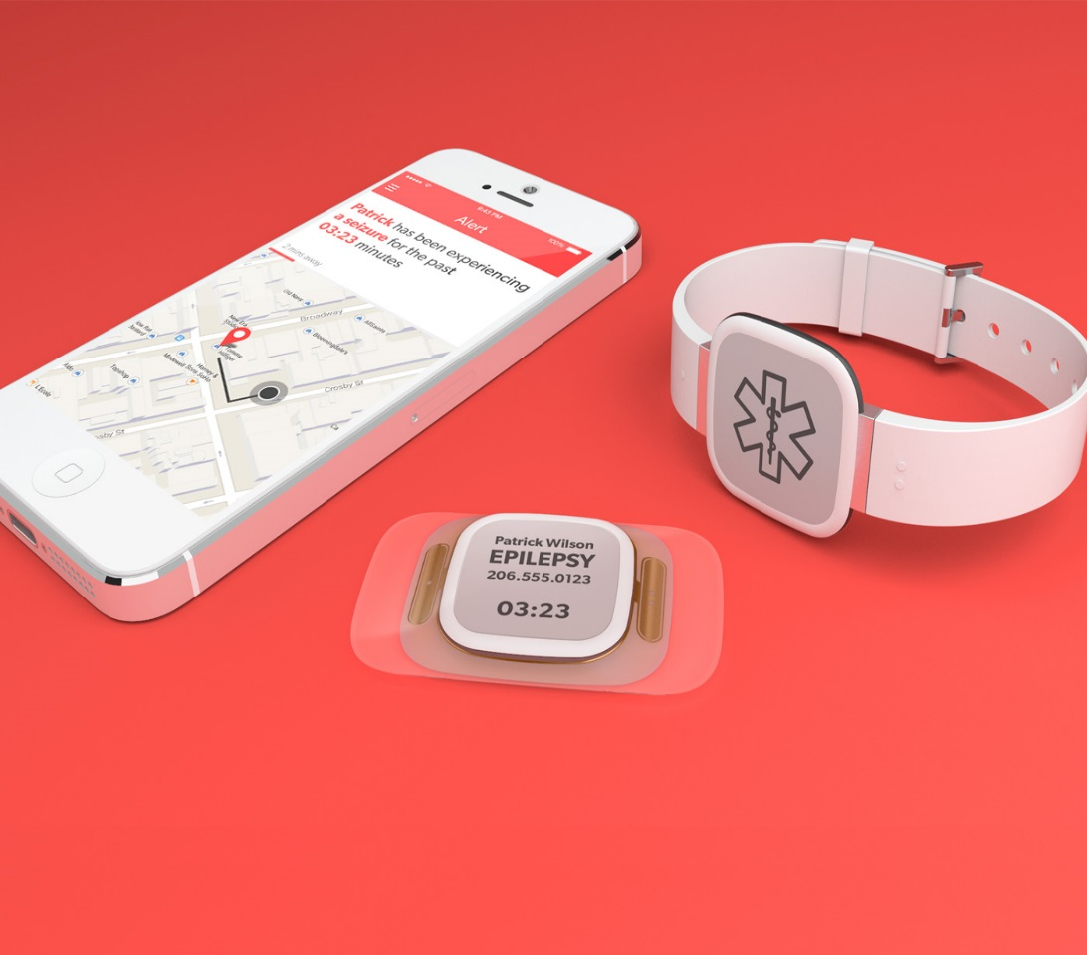
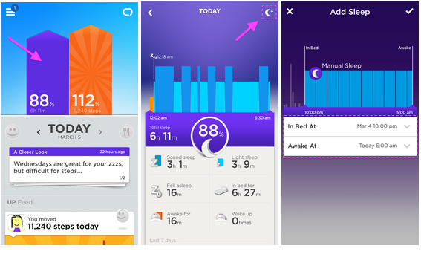
IoT Devices – Fitness / Medical Wearable

Slide 12
Basic Equipment
Development board
Connectors: USB, jumper wires
Inputs:
  Sensors (converts analog data to digital data)
  Buttons
  Keypad
  Photoresistors
Outputs: LEDs, others
Breadboards - helps wiring

Slide 13
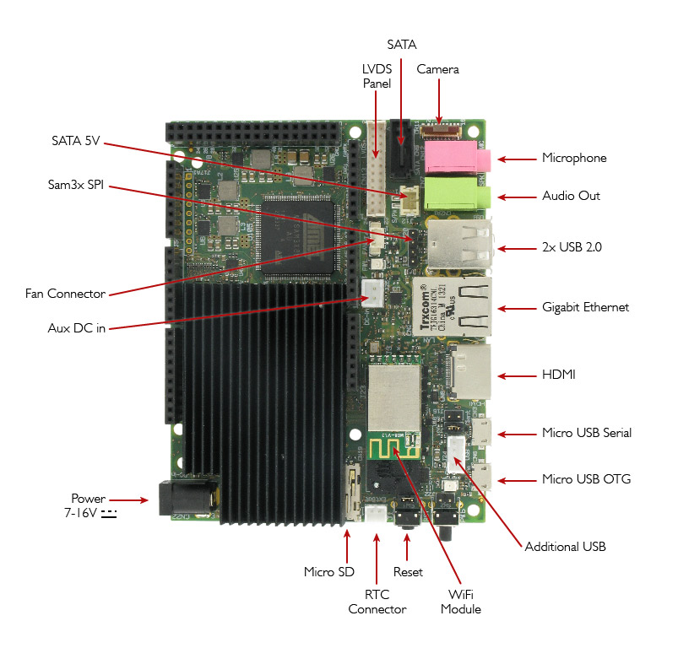
Basic Equipment - Development board
CPU Freescale i.MX 6 ARM Cortex-A9 Quad core 1GHz
GPU Vivante GC 2000 + Vivante GC 355 + Vivante GC 320
Integrated accelerators for 2D, OpenGL® ES2.0 3D and OpenVG™
Atmel SAM3X8E ARM Cortex-M3 CPU (same as Arduino Due)
RAM DDR3 1GB
Arduino-compatible R3 1.0 pinout
HDMI and LVDS + Touch
2 Micro USB (1 OTG type a+b)
2 USB type A (x2) and 1 USB connector (requires a specific wire)
Analog Audio and Mic
CSI Camera Connection
on board Micro SD card reader (boot device)
Ethernet RJ45 (10/100/1000 MBit)
WiFi Module

Slide 14
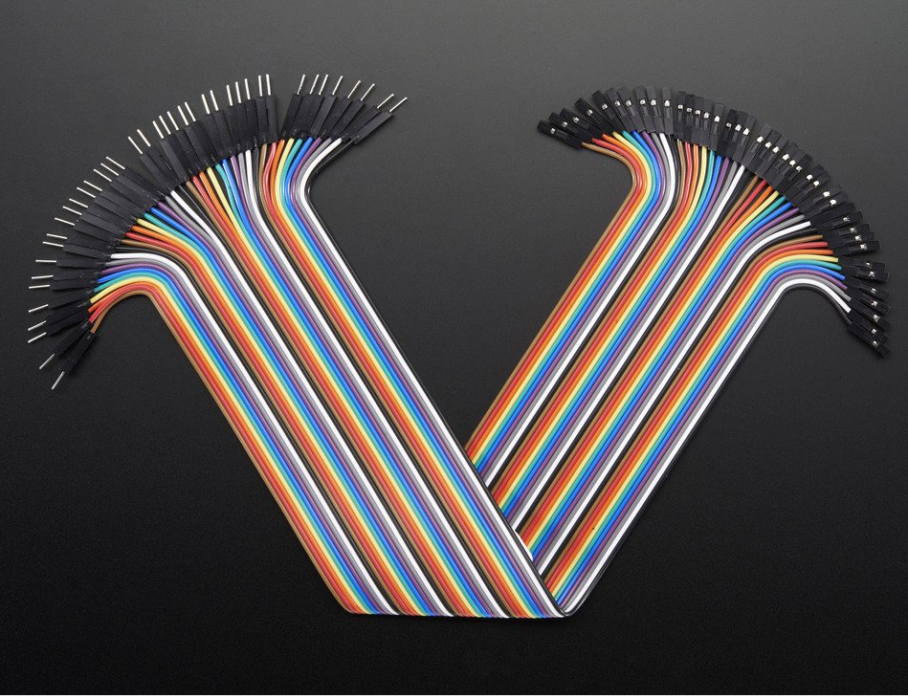
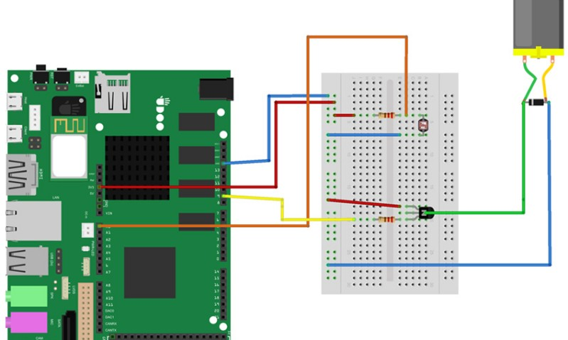
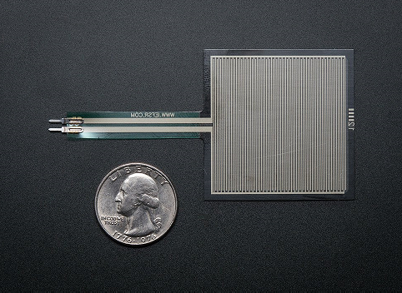
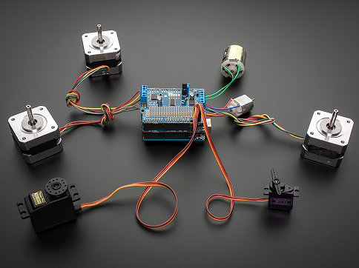
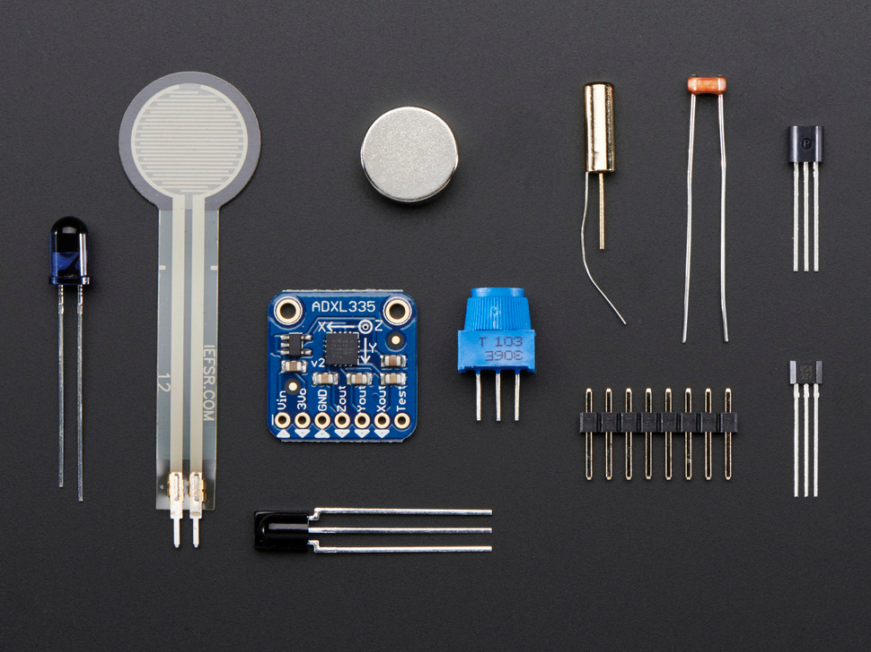
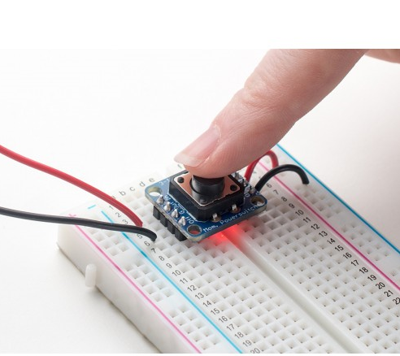
Basic Equipment - Components

Slide 15
Benefits & Risks
Societal Benefits of IoT
The main goal of IoT is to make life easier
Depend a little less on people
Risks
Social isolation
Dependence on technology and infrastructure
Privacy
Security

Slide 16

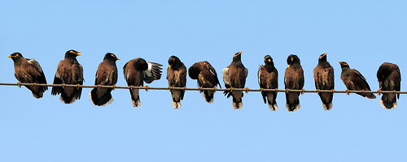
LEC Chat - Intro
client-server application using TCP sockets
Features:
  Presents predefined discussions lists:
    muzica, filme, munca, diverse
  Chat client
    Discover the list of the connected clients
      listclients
    List the information about a certain client
      infoclient <clientname>
    Join a discussion list
      joinlist <listname>
    Leave a discussion list
      leavelist <listname>
    Send a message to a certain client
      sendmsg <clientname> <message>
    Send a message to a discussion list
      sendlist <listname> <message>
Note:
  sizeof(clientname) < 9
  sizeof(listname) < 9
  sizeof(message) < 100

Slide 17
LEC Chat - Tasks
  Step 1 – Source setup
    Copy the lecchat archive
Step 2 – Arduino setup
  Program the Arduino with arduino_serial_example.ino for LED blinking commanded via serial
Step 3 – Sources compilatio
  Compile the lecchat
    make
Step 4 – First run of Chat Client
  Run the chat client:
    ./client <name> <server_ip> <server_port>
      name – max 9 characters
  Test the chat: exchange messages with the other peers
Step 5 – Led Blink
  Close the chat client: quit
  Introduce the led blinking in the chat:
    when a message is received with payload “light_switch” the led state is changed
Step 6 - Have Fun

Slide 18
Nice to read
Mark Weiser – The Computer for the 21st Century
https://www.ics.uci.edu/~corps/phaseii/Weiser-Computer21stCentury-SciAm.pdf

Slide 19
Sources
The Linley Group
Coursera
UDOO
Wikipedia

