Slide 1
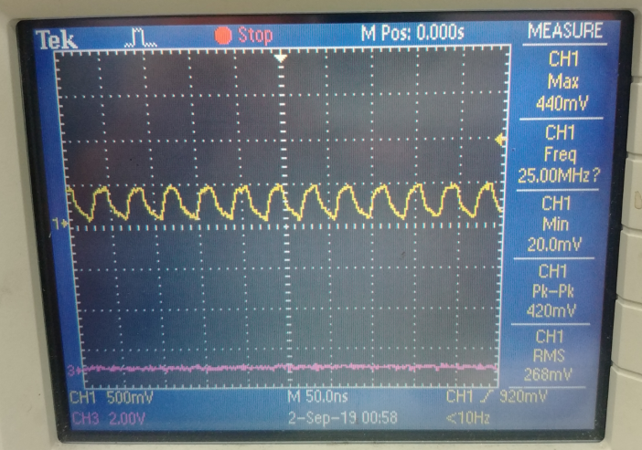
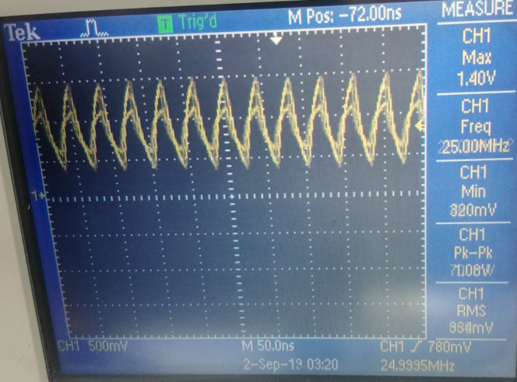
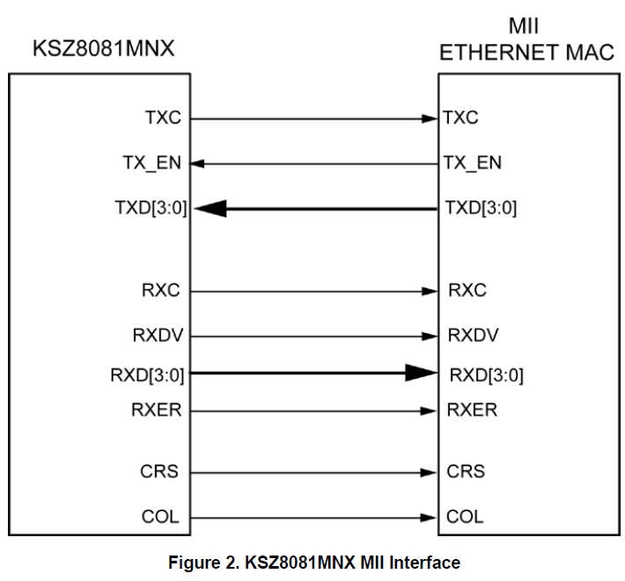
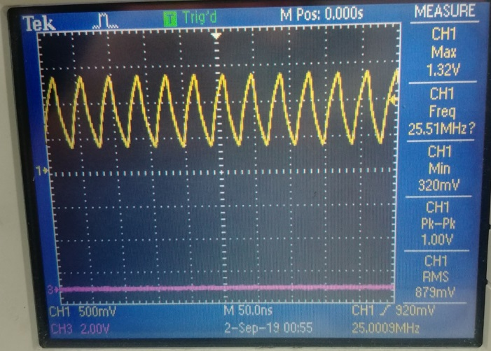
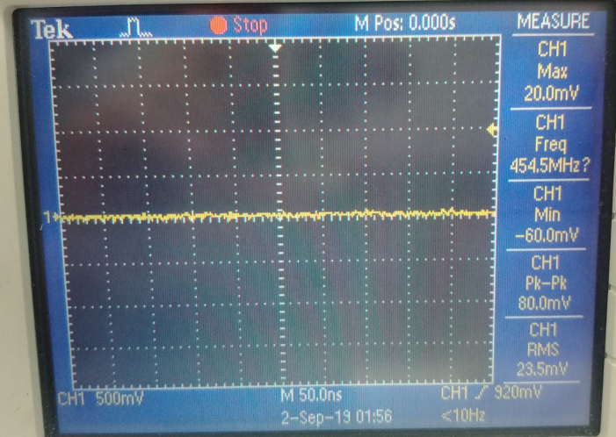
PHY
1
2
3
A.1
B.1
0. Applied IC
1) Applied CPU : i.MX8MM (MAC included, possible RGMII/MII)
2) Applied PHY IC : KSZ8081MNX (Only MII mode)
1. Symptom
A) ping communication between [PHY]-[MAC] is impossible (MAC setting : MII mode)
Picture A.1) : when connecting <TXC line> between [PHY]&[MAC] measuring <TXC line>
Picture A.2) : when cutting <TXC line> between [PHY]&[MAC] and measuring <TXC line > of PHY side.
Picture A.3) : when cutting <TXC line> between [PHY]&[MAC] and measuring <TXC line > of MAC side.
>> 25MHz Clock comes out from PHY side, Clock does not come out from MAC,
Voltage level decreases when connected to each other
B) Ping communication between [PHY]&[MAC] is possible, but sometimes disconnection(MAC setting: RGMII)
Picture B.1) when connecting <TXC line> between [PHY]&[MAC] measuring <TXC line>
>> 25MHz clock comes out both PHY & MAC
So, Ping communication seems sometimes possible because the signal is overlapped,
but there is a disconnection depending on the voltage level.
2. Review for RGMII vs MII
1) RGMII : TXC(Tx Clock) go to from [MAC] to [PHY]
2) MII : TXC(Tx Clock) go to from [PHY] to [MAC] → Our Case
3. Symptom prediction
1) We suspect the setting for “ENET_TXC“ net(Ball no.: AG24) of i.MX8MM for MII mode seems to be wrong.
4. Request
1) please share a patch or SW guide for MII mode.
2) please share the HW guide for MII mode.
A.2
A.3

Slide 2
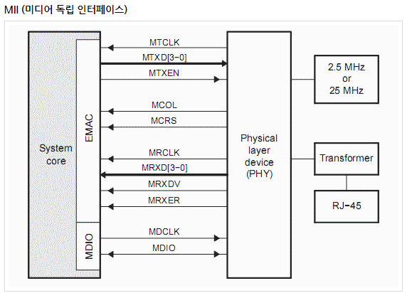
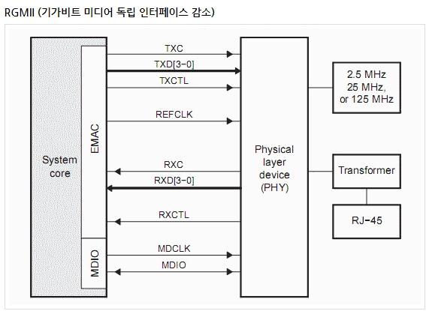
MII vs RGMII
: TXC has different directions

