Slide 1
iMX6x Video Processing Unit (VPU) and Use-case Demos
VPU Capabilities, Performance, Architecture, Operation, MM processing, IPU interface, 2D/3D video, bandwidth & bus-load, etc.
June 18, 2012

Slide 2
Outline
VPU Performance/Capability Overview
Measured Performance in ER5+
VPU Architecture Overview
VPU Programmable Engine
VPU Decoder
VPU Encoder
Tile Format Support
JPEG Processing Unit (JPU)
VPU Software Structure
Stereo 3D
VPU with Multimedia Framework
Use-case Demonstrations

Slide 3
VPU Performance/Capability Overview
Outline
  Performance & capability for decoder
  Performance & capability for encoder and simultaneous encode/decode
  Performance & capability for multi-streams (decodes, encodes)
  Performance & capability for transcoding
  iMX6D/Q VPU vs iMX53 VPU

Slide 4
Performance Overview (Decoder)
 | Standard | Profile | Performance (VPU=266MHz if not specified) |  | Bitrate
HW Decoder | MPEG-2 | Main-High | 2D | 1080i/p+720p@30fps, or 2x 1080p@24fps, or 2x 1080p@30fps (VPU > 300MHz) | 50Mbps
 | H.264 | BP/MP/HP-L4.1 |  |  | 50Mbps
 | VC1 | SP/MP/AP-L3 |  |  | 45Mbps
 | MPEG4 | SP/ASP |  |  | 40Mbps
 | DivX/XviD | 3/4/5/6 |  |  | 40Mbps
 | AVS | Jizhun |  |  | 40Mbps
 | H.263 | P0/P3 |  | 1080p+720p@30fps, or 2x 1080p@24fps, or 2x 1080p@30fps (VPU > 300MHz) | 20Mbps
 | RV10 | 8/9/10 |  |  | 40Mbps
 | Sorenson | -- |  |  | 40Mbps
 | MJPEG | Baseline |  | 8k x 8k | 120Mpel/s
 | On2 VP8 | -- |  | 1080p@30fps (VPU > 300MHz) | 20Mbps
 | H.264-MVC for 3D (FW/HW) | H.264-MVC SHP | 3D | 720p@30fps each view 1080i/p@24fps each view 1080i/p@30fps (VPU > 300MHz) | 40Mbps
 | Simulcast for 3D | Two independent streams |  | 720p@60fps (30fps each view) 1080i/p@24fps each view 1080i/p@30fps (VPU >300MHz) | 50Mbps
 | Frame-packing for 3D | Combine two frames into one |  | 1080p@30fps decode → 1080p@60fps playback (30fps each view) | 50Mbps
HW Post-proc | rotation, mirror, deblocking/deringing

Slide 5
Performance Overview (Encoder & Full-duplex)
 | Standard | Profile | Performance (VPU=266MHz if not specified) |  | Bitrate
HW Encoder | H.264 | BP | 2D | 1080p@30fps 720p@60fps | 20Mbps
 | MJPEG | Baseline |  | 8k x 8k | 160Mpel/s
 | MPEG4 | Simple |  | 720p@30fps | 15Mbps
 | H.263 | P0/P3 |  | 720p@30fps | 15Mbps
 | H.264-MVC for 3D | Stereo HP (no interview prediction) | 3D | 720p@60fps 1080p@48fps (24fps/view, VPU=350MHz) | 20Mbps
 | Simulcast for 3D | Any VPU encoder supported profiles |  | 720p@60fps 1080p@48fps (24fps/view, VPU=350MHz) | 20Mbps
 | Frame-packing | Any VPU encoder supported profiles |  | 1080p@30fps encoding → 1080p@60fps capture (30fps for each view) | 20Mbps
Full-duplex HW Codec | H.264 | BP | 2D | 720p@30fps 1080p@24fps 1080p@30fps (VPU = 350MHz) | 20Mbps
 | MPEG4 | Simple |  | 720p@30fps | 15Mbps
 | H.263 | P0/P3 |  | 720p@30fps | 15Mbps

Slide 6
Performance Overview (Multi-streams)
HW Decoder | Standard | Profile | Max # Streams @ 30fps
 |  |  | D1@ 30fps | 720p@ 30fps | 1080p@ 24fps | 1080p@ 30fps
 | H.264 | BP/MP/HP | 8 | 3 | 2 | 2 (VPU >300MHz)
 | On2 VP8 | -- | 4 | 2 | 1 | 1
 | VC1 | SP/MP/AP | 8 | 3 | 2 | 2 (VPU > 300MHz)
 | MPEG4 | SP/ASP | 8 | 3 | 2 | 2 (VPU > 300MHz)
 | H.263 | P0/P3 | 8 | 3 | 2 | 2 (VPU > 300MHz)
HW Encoder | Standard | Profile | Max # Streams @ 30fps
 |  |  | D1@ 30fps | 720p@ 30fps | 1080p@ 30fps | 1080p@ 24fps
 | H.264 | BP | 6 | 2 | 1 | 2 (VPU=350MHz)
 | MPEG4-SP/H.263 | MPEG4-SP H.263-P0/P3 | 6 | 2 | 1 | 2 (VPU=350MHz)

Slide 7
Performance Overview (Transcoding)
Source Resolution (decoded streaming) | Max # Streams @ 30fps Target Resolution (encoded streaming)
 | SD (720x480) | HD720p (1280x720) | HD1080p@24fps (1920x1080) | HD1080p@30fps (1920x1080)
SD | 4 | -- | -- | --
HD720p | 2 | 2 (24fps, VPU=266MHz) 2 (30fps, VPU=350MHz) | -- | --
HD1080p | 1 | 1 | 1 | 1 ( VPU = 350MHz)

Slide 8
iMX6x VPU vs iMX53 VPU
Enhancements | iMX53 | iMX6x
Clock rate | 200MHz | 266MHz (Will change the VPU spec to 350MHz)
Video Decoder Perf. | 1080i/p@30fps, No 3D support | 1080i/p@60fps, 3D support at 30fps per view
Video Encoder Perf. | 720p@30fps | 1080p@30fps
VP8 decoder | No | Supported
AVS decoder | No | Supported
Theora decoder | No | Partial HW support (no plan to enable it yet)
JPEG Decoder Performance | 40Mbps/sec at YUV444 format (400, 420, 422, 444) | 120Mbps/sec at YUV444 format (400, 420, 422, 444)
JPEG Encoder Performance | 80Mbps/sec at YUV422 format (400, 420, 422) | 160Mbps/sec at YUV444 format (400, 420, 422, 444)
Decoding of H.264-MVC S3D and other S3D streams | No | Supported at 1080i/p@30fps for each view
Encoding of H.264 MVC S3D video | No | Support ed at 720p@30fps for each view (no interview prediction)
Tiled format | No | Supported (for bandwidth reduction)
2D cache | No | Cache used for bandwidth reduction for encoder (motion estimation) and decoder (motion compensation)

Slide 9
Measured Performance in ER5+
Outline
  Measured performance for video playback
  Measured performance for video encoder
  Measured performance for transcoding

Slide 10
Measured Performance (Decoder)
Video clips | Video content complexity | Maximum measured perf. at 270MHz | Maximum measured perf. at 352MHz
Sunflower (self-generated) | H264-HP, 40Mbps, 1080p | Effective Dec : 57fps Actual Display: 56fps | Effective Dec : 68fps Actual Display: 60fps
Fantastic #4 (A Blu-ray clip) | H264-HP, 37Mbps, 1080p | Effective Dec : 59fps Actual Display : 59fps | Effective Dec : 74ps Actual Display : 60fps
Avatar (Youtube) | H264-HP, 3.5Mbps, 1080p | Effective Dec: 80fps Actual Display: 60fps | Effective Dec: 100fps Actual Display: 60fps
Sherlock (A movie Trailer) | H264-HP, 11Mbps, 1080p | Effective Dec: 70fps Actual Display: 60fps | Effective Dec: 86fps Actual Display: 60fps
A FSL demo clip | H264-HP, 10Mbps, 1080p | Effective Dec: 73fps Actual Display: 60fps | Effective Dec: 89fps Actual Display: 60fps
Note:
Performance measured in VPU unit test (without multimedia framework).
SabreSD board
Tile format used
VPU = 270 MHz, 352MHz
DDR = 532 MHz
ER5
Performance for Interlaced video not measured yet due to issues for deinterlacing with VDOA

Slide 11
Measured Performance (Encoder)
Video clips (250 frames) | Video content complexity | Maximum measured perf.
Riverbed | H264-BP, 32Mbps, 1080p@30fps | 40fps (VPU=270MHz) 50fps (VPU=352MHz)
Riverbed | H264-BP, 20Mbps, 1080p@30fps | 41fps (VPU=270MHz) 51fps (VPU=352MHz)
Riverbed | H264-BP, 10Mbps, 1080p@30fps | 42fps (VPU=270MHz) 52fps (VPU=352MHz)
Note:
Performance measured in VPU unit test (without multimedia framework).
SabreSD board
Tile format used
VPU = 270 MHz, 352MHz
DDR = 532 MHz
ER5
YUV source data in file in SD card (file reading time not count in performance)

Slide 12
Measured Performance and Busload (Transcoding)
Transcoding | Transcoding description | Maximum measured performance | Observed bus-load
MPEG2→H264 | Tiled format; Decode 1080p MPEG2 video, and display it via HDMI without resizing, and meanwhile re-encode to H264-BP, 1080p. | 27fps (VPU=266MHz) 35fps (VPU=352MHz) Tiled format; | ~72% (with ~20% for GUI and others) ~78% (with ~20% for GUI and others)
MPEG2→H264 | Linear format; Decode 1080p MPEG2 video, and display it via HDMI with resizing to 720p, and meanwhile re-encode to H264-BP, 720p. | 22fps (VPU=266MHz) 24fps (VPU=352MHz) Linear format | ~82% (with ~20% for GUI and others) ~84% (with ~20% for GUI and others) -Not too much improvement for VPU=352MHz due to bandwidth limitation.
MPEG4→H264 VC1→H264 | Decode 720p MPEG4/VC1, etc, and display it via HDMI without resizing, and meanwhile re-encode to H264-BP, 720p, in <20Mbps | >=50fps(VPU=266MHz) >= 60fps(VPU=352MHz)
Note:
Performance measured in VPU unit test (without multimedia framework).
SabreSD board
Linear format used (tile format not ready for transcoding)
VPU = 270 MHz, 352MHz
DDR = 532 MHz
ER5 with some Gstreamer patches for tiled format

Slide 13
VPU Architecture Overview
Outline
  Video coding standard algorithm and process
  Architecture in top-level view
  Architecture in HW view
  Architecture in SW view
  VPU-IPU interface

Slide 14
Top-view of video encoding/decoding algorithm (H.264 example)
Bitstream
Output
Video Input
+
Transform &
Quantization
Entropy
Coding
-
Inverse Quantization
& Inverse Transform
Intra/Inter Mode
Decision
+
+
Motion
Compensation
Intra
Prediction
Picture
Buffering
Deblocking
Filtering
Motion
Estimation
(a) encoder
Bitstream
Input
Entropy
Decoding
Inverse Quantization
& Inverse Transform
+
Deblocking
Filtering
Video
Output
+
Intra/Inter Mode
Selection
Picture
Buffering
Intra
Prediction
Motion
Compensation
(b) decoder

Slide 15
VPU Architecture Overview (Top-level view)
Bitstream parser & control
Freescale drives this IP development in terms of roadmap, API’s and Firmware.
This is our 6th instantiation of this IP from our vendor (mature technology).
Very flexible solution that allows us to customize the feature set of each product to the market requirements without compromising power or die size.
Freescale works closely with C&M to optimally integrate VPU into all i.MX
Host
processor
APB3
interface
BIT Proc.
Core
APB3
6KB Data Mem
Host
interface
20KB Prog Mem
External
memory
Primary AXI
VPU
Enc, dec, and post process
Decoding
process
Encoding
process
On-chip
RAM
Secondary AXI
Pre- & Post-proc
Flexible and optimized area-power accelerator architecture
  Embedded DSP core providing a certain level of flexibility & programmability (e.g., be able to support H.264-MVC-3D by only firmware change and currently being done in iMX6x VPU)
  Shared logic & SRAM for encoder and decoder for optimizing area and minimizing power with clock gating (vs separate enc and dec HW in other vendors )
  On-chip RAM with secondary AXI option for reducing memory bandwidth (makes it competitive in performance).

Slide 16
VPU Architecture Overview (HW view)
BPU
BIT DSP
HW
Accele-rator
APB
1st AXI
2nd AXI
Host I/F
Post-processor
(Deblocking, Deringing, Rotation)
APB-to-IPB wrapper
GDI-to-AXI wrapper
Macroblock Sequence
JPEG codec
DMA
IPB (Internal Peripheral Bus)
GDI Arbiter
Source Loader
(w/ built-in rotator)
Motion Compensation
Reconstruction
Deblocking Filter
DMA
DMA
DMA
DMA
DMA
DMA
Intra Mode Decision
Intra Prediction
AC/DC Prediction
Sub-sampler
2-D Cyclic CACHE
Multi-resolutional
Motion Estimation
Motion Compensation
DMA
DMA
DMA
Residual
Transform/
Quantization

Slide 17
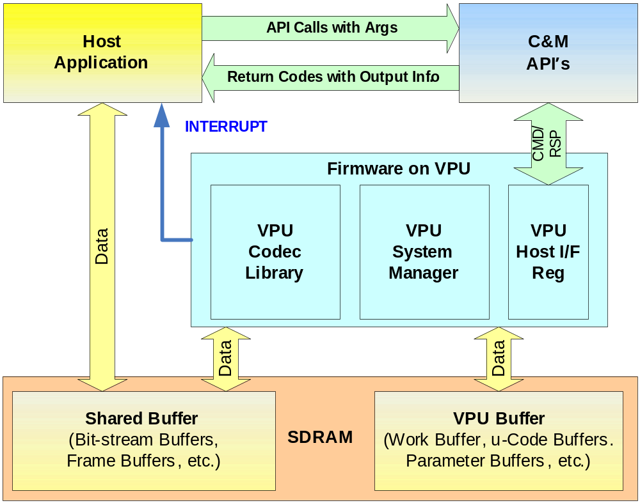
VPU Architecture Overview (SW view)

Slide 18


VPU-IPU Interface
Image Sensor
Display
Image
Processing
Unit (IPU)
Display
Enhancement
HW Accelerated
Video/Graphics
Combining
Image Conversions:
  Resizing (resolution adjustment)
  De-interlacing
  Rotation & Inversion
Display Enhancement:
  Color adjustments and gamut mapping
  Gamma correction and contrast stretching
  Compensation for low-light conditions and backlight reduction
Image
Conversions
Camera Preview
Image
Conversions
Graphics
Generation
VDOA
Frame Buffers
Frame Buffers
Frame Buffers
Frame Buffers
Video Processing Unit
Compression
De-compression
with post processing
Memory
Combining
with Audio
Separation
from Audio
Communication
Network
Audio
Compression
De-compression

Slide 19
VPU Decoder
Outline
  Decoder pipeline
  Decoder API and process flow
  Decoding operation steps
  Major differences between iMX6x VPU and iMX5x VPU

Slide 20
Video Decoder Process Pipeline (example of H264/RV/AVS/VP8 decoder)
Parsing bitstream for macroblocks
Loading reference data for inter-prediciton
Inverse transform/quantization
Generating inter-predicted macroblock
Intra-prediction & Reconstructing macroblocks
Deblocking filtering
Writing decoded macroblocks

Slide 21
VPU driver API (decoder)
vpu_init()
vpu_DecOpen()
Example VPU Decode Flow for a single instance
vpu_DecUpdateStreamBuffer()
vpu_Init()
vpu_Deinit()
vpu_IsBusy(), jpu_IsBusy()
vpu_SleepWake()
vpu_GetVersionInfo();
vpu_WaitForInt()
vpu_SWReset()
IOGetPhyMem(),IOFreePhyMem()
IOGetVirtMem(), IOFreeVirtMem()
IOGetIramBase()
vpu_DecOpen();
vpu_DecClose();
vpu_DecSetEscSeqInit();
vpu_DecGetInitialInfo();
vpu_DecRegisterFrameBuffer();
vpu_DecGetBitstreamBuffer();
vpu_DecUpdateBitstreamBuffer();
vpu_DecStartOneFrame();
vpu_DecGetOutputInfo();
vpu_DecBitBufferFlush();
vpu_DecGiveCommand()
vpu_DecClrDispFlag()
vpu_DecSetEscSeqInit(handle, 1)
vpu_DecGetInitialInfo( )
Vpu_DecSetEscSeqInit(handle, 0)
vpu_DecRegisterFrameBuffer()
vpu_DecStartOneFrame( )
Vpu_IsBusy()
Yes
No
vpu_DecGetBitStreamBuf( )
vpu_DecGetOutputInfo( )
Yes
Decode_finished
Lack of bitstream
No
No
Yes
Process output picture
Fill bitstream ring buffer
vpu_DecClrDisp( )
End of stream
Yes
Exit
No
No
Yes
vpu_decUpdateBitstreamBuffer (handle, size)
vpu_decUpdateBitstreamBuffer (handle, 0)
vpu_DecClose()
vpu_UnInit
End

Slide 22
Decoder Operation Steps
Call vpu_Init() to initialize the VPU
Open a decoder instance using vpu_DecOpen()
To provide the proper amount of bitstream, get the bitstream buffer address using vpu_DecGetBitstreamBuffer()
After transferring the decoder input stream, inform the amount of bits transferred into the bitstream buffer using vpu_DecUpdateBitstreamBuffer()
Before starting a picture decoder operation, get the crucial parameters for decoder operations such as picture size, frame rate, required frame buffer size using vpu_DecGetInitialInfo()
Using the returned frame buffer requirement, allocate the proper size of the frame buffers and convey this data to the i.MX 6Dual/Quad VPU using vpu_DecRegisterFrameBuffer()
Start a picture decoder operation picture-by-picture using vpu_DecStartOneFrame()
Wait for the completion of the picture decoder operation interrupt event
Check the results of the decoder operation using vpu_DecGetOutputInfo()
After displaying nth frame buffer, clear the buffer display flag using vpu_DecClrDispFlag()
If there is more bitstream to decode, go to Step 7, otherwise e go to the next step
Terminate the sequence operation by closing the instance using vpu_DecClose()
Call vpu_UnInit() to release the system resources

Slide 23
Major API differences from iMX5x VPU
“Streaming mode with prescan” in iMX5x VPU is replaced by “rollback” mode in iMX6x VPU. Reason:
        Simplify the firmware
        Improve the performance
Add “MvcPicInfo” for S3D in DecOutputInfo
    typedef struct {
    int viewIdxDisplay; //view index of display frame buffer
    int viewIdxDecoded; //view index of decoded frame buffer
    } MvcPicInfo
Add “AvcFpaSei” for frame-packing for S3D in DecOutputInfo.
    typedef struct {
    ……
    unsigned frame_packing_arrangement_id;;
    unsigned frame_packing_arrangement_type
    unsigned frame_packing_arrangement_repetition_period;
    ……
    } AvcFpaSei

Slide 24
VPU Encoder
Outline
  Encoder pipeline
  Encoder API and process flow
  Encoder operation steps
  Encoder visual quality
  Encoder rate control concept
  Encoder configuration example

Slide 25
Video Process Flow (example pipeline of H264 encoder)
Loading a source MB to encode
Loading reference data
Motion estimation (1st step)
Loading reference data (luma only)
Intra mode decision (1st step)
Motion estimation (2nd step)
Intra mode decision (2nd step)
Motion estimation (3rd step)
Loading reference data (Chroma only)
Motion Compensation
Reconstruction path
Intra-prediction for inv. Q/T
Intra-prediction for Quant/Transform
Write-back unfiltered data
Entropy Coding (bitstream packing)
Deblock filtering
Write-back data

Slide 26
VPU driver API (encoder)
vpu_init()
vpu_EncOpen()
Example VPU Encode Flow for a single instance
vpu_EncGetInitialInfo( )
vpu_DecRegisterFrameBuffer()
vpu_EncGiveCommand( )
vpu_Init()
vpu_Deinit()
vpu_IsBusy(), jpu_IsBusy()
vpu_SleepWake()
vpu_GetVersionInfo()
vpu_WaitForInt()
vpu_WaitForInt()
vpu_SWReset()
IOGetPhyMem(),IOFreePhyMem()
IOGetVirtMem(), IOFreeVirtMem()
IOGetIramBase()
vpu_EncOpen();
vpu_EncClose();
vpu_EncGetInitialInfo();
vpu_EncRegisterFrameBuffer()
vpu_EncGetBitstreamBuffer();
vpu_EncUpdateBitstreamBuffer();
vpu_EncStartOneFrame();
vpu_EncGetOutputInfo();
vpu_EncGiveCommand();
Lack of source data ?
No
Yes
Copy source data to source frame buffer
No
vpu_EncStartOneFrame( )
No
vpu_IsBusy() ?
Yes
vpu_EncGetOutputInfo()
vpu_EncClose()
Process output data
vpu_UnInit
Exit
Yes
End

Slide 27
Encoder Operation Steps
Call vpu_Init() to initialize the VPU
Open a encoder instance using vpu_EncOpen()
Before starting a picture encoder operation, get crucial parameters for encoder operations such as required frame buffer size using vpu_EncGetInitialInfo()
Using the returned frame buffer requirement, allocate size of frame buffers and convey this information to the VPU using vpu_EncRegisterFrameBuffer()
Generate high-level header syntaxes using vpu_EncGiveCommand()
Start picture encoder operation picture-by-picture using vpu_EncStartOneFrame()
Wait the completion of picture encoder operation interrupt event
After encoding a frame is complete, check the results of encoder operation using vpu_EncGetOutputInfo()
If there are more frames to encode, go to Step 4, otherwise go to the next step
Terminate the sequence operation by closing the instance using vpu_EncClose()
Call vpu_UnInit() to release the system resources

Slide 28
i.MX6x VPU encoder—Visual quality
At the same frame rate, bitrate, and resolution, the visual quality of iMX6x VPU has similar visual quality to iMX5x VPU
Visual quality can be measured as:
  Objective such as PSNR, SSIM, etc
  Subjective
Encoder visual quality is determined by:
  Rate control algorithm for CBR
  Prediction algorithms
  Entropy coding methods
  Encoder configurations
Visual quality and rate control accuracy can be improved by fine-tuning the VPU encoder rate control algorithm and parameters in firmware.

Slide 29
i.MX6x VPU encoder—Rate control basic concept, leaking bucket
Pouring in variable rate
(adjusted by QP)
Buffer
level
QP
bits
Visual
quality
Leaking in constant rate
Buffer level
Buffer
level
QP
bits
Visual
quality

Slide 30
i.MX6x VPU encoder— Encoder configuration example
//General setting
vpu_enc->width=704 // picture width
vpu_enc->height=480 // picture height
vpu_enc->tgt_framerate=30 // frame rate
avc_constrainedIntraPredFlag=0 // constrained_intra_pred_flag
encOP->gopSize = vpu_enc->gopsize //e.g., 30, GOP picture number (0 : only first I, 1 : all I, 3 : I,P,P,I,)
//DEBLKING FILTER
avc_disableDeblk = 0 // disable_deblk (0 : enable, 1 : disable, 2 : disable at slice boundary)
avc_deblkFilterOffsetAlpha = 0 // deblk_filter_offset_alpha (-6 ~ 6)
avc_deblkFilterOffsetBeta = 0 // deblk_filter_offset_beta (-6 ~ 6)
avc_chromaQpOffset = 0 // chroma_qp_offset (-12 ~ 12)
//SLICE STRUCTURE
slicemode.sliceMode = 0 // slice mode (0 : one slice, 1 : multiple slice)
slicemode.sliceSizeMode = 0 // slice size mode (0 : slice bit number, 1 : slice mb number)
slicemode.sliceSize = 0 // slice size number (bit count or mb number)
//RATE CONTROL
vpu_enc->bitrate=1024 //bit rate in kbps (ignored if rate control disable)
vpu_enc->encOP->initialDelay=0 // delay in ms (initial decoder buffer delay) (0 : ignore)
vpu_enc->encOP->vbvBufferSize=0 // VBV buffer size in bits (0 : ignore)
vpu_enc->encOP->rcIntraQp=40 // rcIntraQp, qp value for constant intra frame QP function,
vpu_enc->max_qp=45 // userQpMax, maximum qp (13 ~ 51)
vpu_enc->min_qp =10 // userQpMin,
vpu_enc->gamma=0 // encOP->userGamma, gamma value in RC (0 ~ 0.99999) x 32768
vpu_enc->rc_interval_mode=0 // rate control interval mode (0 - default mode, 1 - frame based, 2 - slice based, 3 - MB interval)
Vpu_enc->rc_mb_interval=100 // rate control interval, This value is only valid when mode is 3
// ERROR RESILIENCE
vpu_enc->intraRefresh=0 // Intra MB Refresh (0 - None, 1 ~ MbNum-1
//Intra mode selection
vpu_enc->intra16x16_mode_only // For enabling or disaling Intra4x4 mode

Slide 31
Tile format Support
Outline
  Tiled format concept and benefits
  Tiled format handling in Video Data Order Adapter (VDOA)

Slide 32
VPU tiled format support
Linear format storage
Tiled format storage
0
1
14
15
0
1
14
15
0
1
14
15
16
17
30
31
16
17
30
31
32
34
46
47
32
34
46
47
16
17
30
31
32
34
46
47
Why tiled format:
  Much more efficient DDR access
iMX6x VPU supports the following tile format:
  Linear map (Type 0 )
  Tiled macroblock raster frame map (Type 1 )
  Tiled macroblock raster field map (Type 2 )

Slide 33
  Tiled format handling in Video Data Order Adapter (VDOA)
Tiled format handling in Video Data Order Adapter (VDOA)
  The decoded data from VPU is stored in system memory in tiled format (each tile is 16x16 macroblock)
  VDOA converts the tiled data (16x16 tile) into raster-scan format
  VDOA outputs the raster-scan format data to IPU for display
Tiled format storage
Linear format storage
0
1
14
15
0
1
14
15
16
17
30
31
32
34
46
47
VDOA
16
17
30
31
32
34
46
47

Slide 34
JPEG Processing Unit (JPU)
Outline
  JPU overview and facts
  JPU process and pipeline
  API consideration for JPEG/MJPEG codec

Slide 35
JPEG Processing Unit (JPU)
An enhanced JPEG codec with higher performance compared to iMX5x VPU
      A separate JPU HW module without firmware control.
Decoding up to 120Mpixels/sec at YUV444 format
      Support YUV4:0:0, 4:2:0, 4:2:2, and 4:4:4 formats
      Performance will be doubled for the input format of YUV4:2:0
Encoding up to 160Mpixels/sec at YUV444 format
      Support YUV4:0:0, 4:2:0, 4:2:2, and 4:4:4 formats
      Performance will be doubled for the input format of YUV4:2:0
JPEG API consideration
      Linux libjpeg compatible API ?
      iMX5x VPU compatible API

Slide 36
JPEG Processing Unit (JPU)—encoder example
Pre/Post processor
Quantized Coeff. memory
Getting YUV image data
T/Q
VLC
Raw image DMA
Pre-processing
BitStream DMA
(1) Read multiple MCUs for 4:2:0, 4:2:2 and 4:4:4 format
(2) Quantized Coefficient memory generate non-zero flag
Transform & Quantization
Transform & Quantization
JPEG decoding process is the inverse of encoding process

Slide 37
JPEG API Consideration
  Consider to support Linux libjpeg compatible API for still image decoding
        Adding a wrapper on top of the existing VPU API.
        Difficult to fully support libjpeg API
  iMX5x compatible API for local MJPG file playback (file-play mode) and streaming mode

Slide 38
VPU Software Structure
Outline
  Software structure, kernel space vs user space
  Kernel space source code structure
  User space source code structure

Slide 39
VPU Software Structure
The VPU software can be divided into two parts:
the kernel driver : takes responsibility for system control and reserving resources(memory/IRQ). It provides an IOCTL interface for the application layer in user-space as a path to access system resources.
user-space library: the application in user-space calls related IOCTLs and codec library functions to implement a complex codec system.

Slide 40
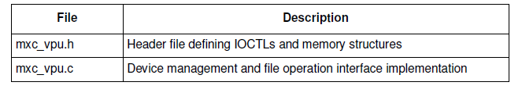
Source Code Structure (Kernel Driver)
The table below lists the kernel space source files available in the following directories:
<ltib_dir>/rpm/BUILD/linux/arch/arm/plat-mxc/include/mach/
<ltib_dir>/rpm/BUILD/linux/drivers/mxc/vpu/

Slide 41
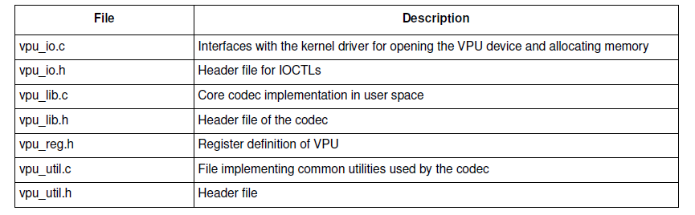
Source Code Structure (User space)
The table below lists the user-space library source files available in the
<ltib_dir>/rpm/BUILD/imx-lib-xxxx/vpu directory:

Slide 42
Stereo 3D
Outline
  S3D coding methods
    Simulcast method
    Combined Frame (Frame Packing, or Frame compatible)
    H.264-MVC S3D

Slide 43
Stereo 3D Coding Methods
Name | Coding method
Simulcast Method | Left view and right view coded separately in a simulcast way
Frame-packing Method | Combination of two views into one frame in various frame packing method MPEG-2 Multi-view profile using temporal L/R interleaving for stereo video H.264 Stereo SEI message and Frame Packing Arrangement SEI message allow various methods of L/R packing (Frame Compatible S3D) Temporal interleaving spatial row/column, spatial side-by-side, Spatial up-and-bottom, checkerboard (quincunx),
H.264-MVC S3D Method | Coded in H.264-MVC Stereo High Profile with base view and enhanced view, with the exploitation of interview prediction

Slide 44
Simulcast Method
Left view video input
Encode
Decode
Left view output
Bitstream left and right view
Channel
Right view video input
Encode
Decode
Right view output

Slide 45
Frame-Packing Method
top-bottom
row-interleaving
side-by-side
column-interleaving
checkerboard
Temporal interleaving
t
1st view
2nd view

Slide 46
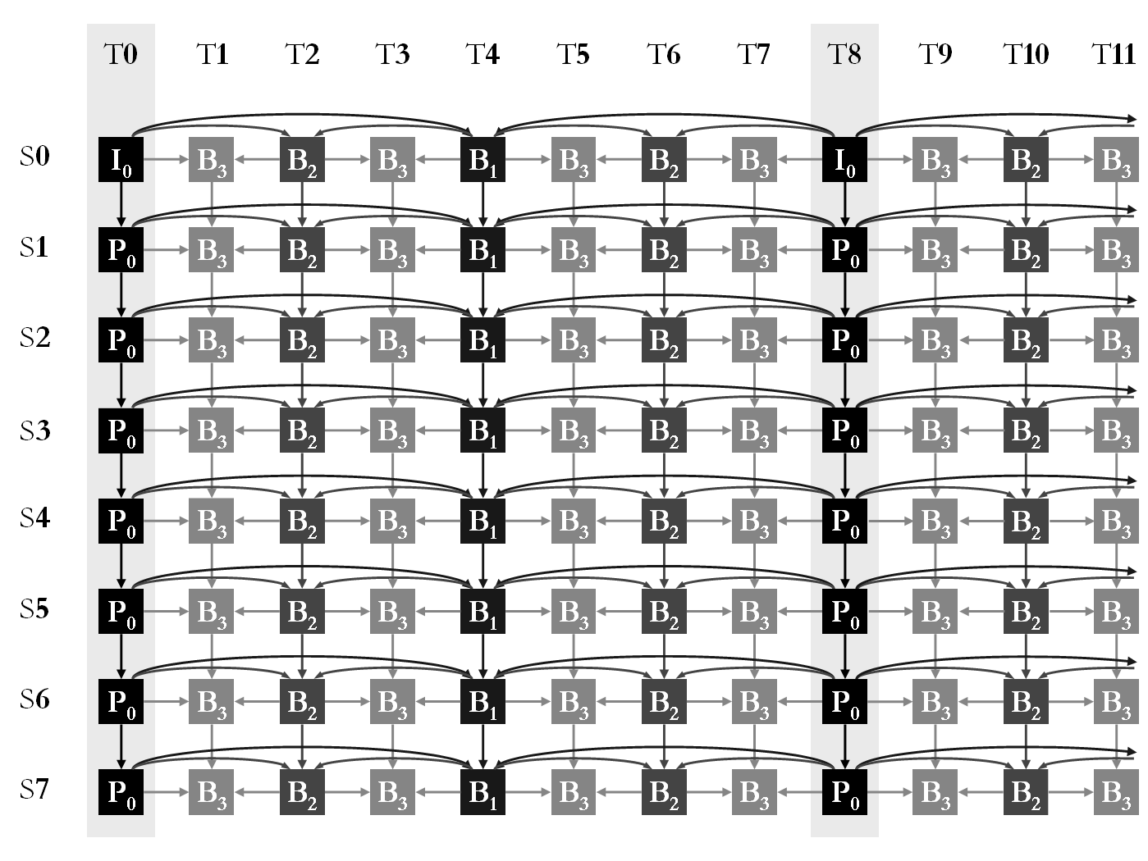
H.264-MVC-S3D Method
S3D can be generated using only two views, S0 and S1

Slide 47
VPU with Multimedia Framework
Outline
  Multimedia Framework
  Supported Multimedia Format

Slide 48
Video playback using VPU
Video players
(Totem, WMP)
Video players
(Samsung Muon,
Android Gallery)
Multimedia framework (Gstreamer, Dshow)
Other multimedia frameworks
(OpenCORE/stageFright, Flash10, etc)
pipeline architecture
audio
decoder
audio
sink
source
plug-in
parser
plug-in
video
decoder
video
sink
OpenMax-IL
VPU driver
VPU HW

Slide 49
Supported Streaming Containers
MP4:
  Playback: MPEG4, H.264, H.263
  Capture, MPEG4, H.264
AVI:
  Playback: MPEG4, Divx/Xvid, H.264, WMV/VC1
  Capture: MPEG4, H.264
MPEG2-TS: Playback: MPEG2, H.264, VC1
MPEG2-PS: Playback: MPEG2, H.264, MPEG4, AVS
FLV: Playback: H.264, Sorenson, VP6
ASF: Playback: WMV/VC1
WebM: Playback: VP8
RMVB: Playback: RV8/9/10
Matroska (MKV): Playback: MPEG4, Divx/Xvid, H.264, WMV/VC1
3GP: Playback: MPEG4, H.264
Ogg: Playback: Theora

Slide 50
Streaming Protocol Support
Format | ASF | AVI | MP4 | MPG2 | MKV | OGG | FLV
HTTP | Y | Y | Y | Y | Y | Y | Y
DLNA | Y | Y | Y | Y | Y | Y | Y
HTTP live | N | N | N | N | N | N | N

Slide 51
Use-case Demos
Outline
  Demo for unit test (linear format vs tile format)
    Single-stream playback
    Transcoding
  Demo for Gstreamer (linear format vs tile format)
    Single-stream playback
    Dual-stream playback
    Transcoding

Slide 52
#####Demo Case 1, Unit Test, Playback, VPU=270MHz#################
#####Unit test with tiled format and display to 1080p hdmi display#######
cp /home/linaro/mount_sd/sunflower_2B_2ref_WP_40Mbps.264 /dev/shm/tmp_video
/unit_tests/mxc_vpu_test.out -D "-i /dev/shm/tmp_video -f 2 -t 1 -a 60 -y 1"
/unit_tests/mxc_vpu_test.out -D "-i /dev/shm/tmp_video -f 2 -t 1 -a 60 -y 0"
#####Demo Case 2, Unit Test, Transcoding, VPU=270MHz####################
#####Unit test with linear format and display to 720p or 1080p hdmi display#####
#####Unit test with tile format is not ready yet##############################
    /unit_tests/mxc_vpu_test.out -T "-i /home/linaro/mount_sd/Coral_Reef_Adventure_720_video.wmv3 -f 3 -t 1 -x 0 -y 0 -a 60 -w 1280 -h 720 -o /dev/shm/transcode.264 -q 25 -g 30"
    cp /home/linaro/mount_sd/mpeg2_1080p25_video1.mpv /dev/shm/tmp_video
    /unit_tests/mxc_vpu_test.out -T "-i /dev/shm/tmp_video -f 4 -t 1 -x 0 -y 0 -a 60 -w 1920 -h 1088 -o /dev/shm/transcode.264 -q 25 -g 30“

Slide 53
#####Demo Case 3: Gstreamer, Single stream decoding, ~60fps VPU=270MHz##########
#####Decoding H264 1080p@10Mbps, tiled format and display to 1080p hdmi display######
sudo cp /home/linaro/mount_sd/Container_clips/Avatar_1920x1080_30fpsH264_2x44100AAC_3.6Mbps_246sec.mp4 /dev/shm/tmp_video
time gst-launch filesrc location=/dev/shm/tmp_video typefind=true ! aiurdemux ! vpudec framedrop=false ! queue max-size-buffers=2 ! mfw_v4lsink sync=false
##### Demo Case 4: Gstreamer, Single stream decoding, <60fps VPU=270MHz###########
#####Decoding H264 1080p@37Mbps, tiled format and display to 1080p hdmi display######
sudo cp /home/linaro/mount_sd/Container_clips/00017.m2ts /dev/shm/tmp_video
time gst-launch filesrc location=/dev/shm/tmp_video typefind=true ! aiurdemux ! vpudec framedrop=false ! queue max-size-buffers=2 ! mfw_v4lsink sync=false
#####Demo Case 5: Gstreamer, Dual-display with dual streams, 25fps VPU=270MHz#######
#####Decoding two H264 1080p@10Mbps, linear format , 1080p and XGA display#########
gst-launch playbin2 uri=file:///home/linaro/mount_sd/Container_clips/FTF20033_1920x1080_30fpsH264_2x44100AAC_9.7mpbs_137sec.mp4 flags=0x57 video-sink="mfw_v4lsink" &
gst-launch playbin2 uri=file:///home/linaro/Clips/Mosaic_1920x1080_H.264_10mbps.mp4 flags=0x57 video-sink="mfw_v4lsink device=/dev/video18"

Slide 54
#####Demo Case 6, Gstreamer, Transcoding, 27fps for VPU=270MHz###################
#####1080p-MPEG2→1080p-H264 with tiled format and display to 1080p hdmi display#####
time gst-launch filesrc location=/home/linaro/mount_sd/Container_clips/mpeg2_1080p25_new.ts typefind=true ! aiurdemux ! vpudec framedrop=false ! queue max-size-buffers=2 ! tee name=t ! vpuenc codec=avc quant=35 ! matroskamux ! filesink location=/dev/shm/h264.mkv t. ! queue max-size-buffers=2 ! mfw_v4lsink sync=false
#####Demo Case 7, Gstreamer,Transcoding, 30fps for VPU=270MHz###################
#####1080p-MPEG2→VGA-H264 with linear format and display to VGA hdmi display#####
#####Tiled format for transcoding with resizing is not ready yet #######################
time gst-launch filesrc location=/home/linaro/mount_sd/Container_clips/mpeg2_1080p25_new.ts typefind=true ! aiurdemux ! vpudec framedrop=false ! 'video/x-raw-yuv, format=(fourcc)NV12' ! queue max-size-buffers=2 ! tee name=t ! mfw_ipucsc ! 'video/x-raw-yuv, width=640, height=480' ! vpuenc codec=avc quant=30 ! matroskamux ! filesink location=/dev/shm/h264_vga.mkv t. ! queue max-size-buffers=2 ! mfw_v4lsink sync=false

