Slide 1
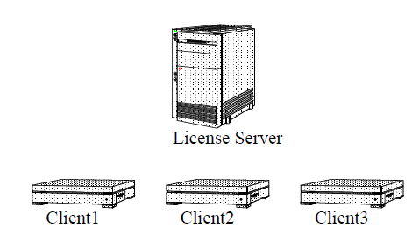
Addendum
How to combine licenses of several CW tools on server side
…
Detailed presentation is :
http://www.freescale.com/webapp/sps/site/overview.jsp?nodeId=015210272624448523#FLOATCOMPANY

Slide 2
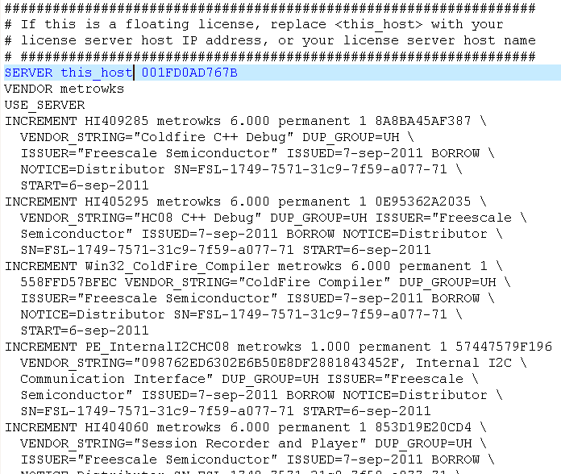
1
2
…
Here we will described and example how to support 2 CW tool version on the server of licenses
You 2 license.dat supplied by Freescale for each of the CW tool versions
Download these from Freescale website (if not done already)
So we have
One file we named « license_HC08.dat » (for 8 bits series of MCU, classic IDE )
Second file we name « license.S12.dat » (for A6 bits series of MCU, classic IDE)

Slide 3
1
2
COPY
…
3
Paste
Edit « license_HC08.dat », replace « this_host » by server host name or ip address and SaveAs with name « license.dat »
Edit file « license_HC12.dat » and Copy all content starting with first line named « INCREMENT » until the end of the file
Edit « license.dat » previously save & Paste the content after the last line of the file
Then save the new « license.dat » file with additionnal content
You have merged the 2 license information from the 2 files into one single file

Slide 4
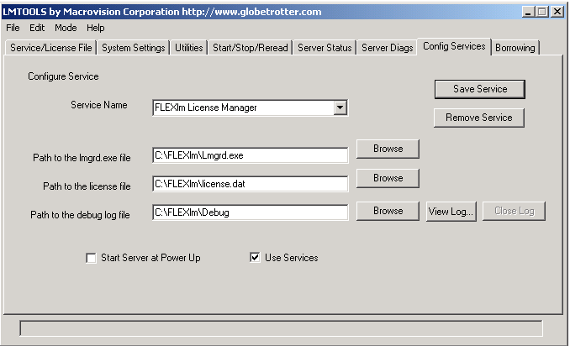
1
3
2
On the server open the flexLM manager
1. Choose the "Config Services" tab (7th tab in the tool’s main window)
Locate the “freshly” created License File on the disk (new merged “license.dat”)
Click on save service
[NOTE]
It might be necessary to STOP and RESTART the FlexLM service so that update information
Of the license.dat is read or just ReRead the license file

Slide 5
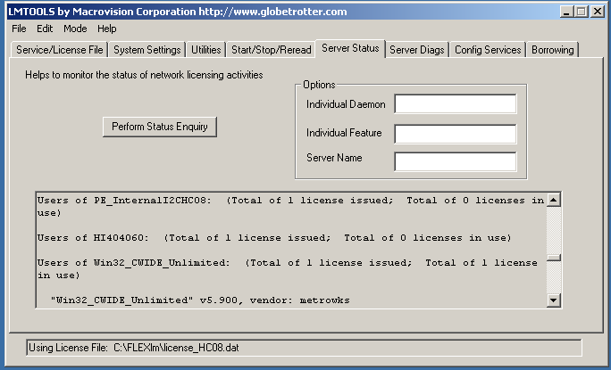
1
2
3
You can check that new list of licenses availables had be added and is listed
Choose the “Server status" tab (5th tab in the tool’s main window)
In the Log windows you see that on one license available on is used by a client
In our example you could check taht both licenses for HC08 and HC12 are availables

Slide 6
Combined licenses of several CW tool
…
Do not forget to install license_HC08.dat and licenses_HC12.dat
both renamed into license.dat onto each client & CW installed directory
(with IP address or Hostname of the server)
This operation could be repeated by adding other license information
from other CW tool & merging license.dat in order to build one unique license.dat used by the server

