Slide 1
How to use Medini for Customer fmeda
Yashwant Singh
Functional Safety Engineer
August 2023

Slide 2
AGENDA
Purpose
Overview of customization process
Licensing Requirements
NXP Medini FMEDA Structure
Medini FMEDA customization Approach
Working with Mission profile
Changing catalog to SN 29500 norms
Working with DC worksheet
Adding Customer specific SM Library
Interpretation of FMEDA results
Customer FMEDA review process

Slide 3
Purpose
The purpose of this document is to enable customers to use Medini safety analysis tool and guide customers to do customizations in NXP default FMEDA.
Provide the processes to be followed for customizations.
Provide walk through of safety analysis structure
  Failure mode effect and diagnostic analysis (FMEDA)
The FMEDA safety analysis is under NDA and not to be shared with others.
Disclaimer:
FMEDA Customization is limited to some parameters validated by the Safety architect (see next slides). NXP Safety expert will review and answer validity of safety concept only on allowed customizable parameters. Review of additional customization beyond NXP’s parameters will require a custom SOW with NXP, as it may require Safety Impact analysis and a change in the safety case.

Slide 4
Overview of customization process
Customer access Medini files from Secure files.
Customer can do FMEDA customizations like:
  Change Mission profiles
  Change the catalog to Sn-norms
  Add customer specific Safety mechanisms
  Update the DC of NXP assumptions
  Update Safe fractions
  Mark SR or NSR
Once the customization is complete, the updated FMEDA needs to be shared with NXP for Review to generate a review checklist report.
  Note: NXP review only includes changes made with DC configurator script.
NXP’s Confirmation Review of safety analysis is invalid for customized FMEDA without this review checklist report.
FAE/Customer configures mission profile or updates catalog. (Done in Prediction Model)
FAE/Customer adds customer specific safety mechanism.
FAE/Customer makes update in DC worksheet.
FAE/Customer uses DC configurator rules to perform:
SM Hide/Unhide
Safety Related or not
Safe fraction
Diagnostic Coverage updates
FAE/Customer shares the final updated Medini Project file to NXP Safety Team for review (Safe assure Community or through FAE)
NXP Safety experts review and prepares review checklist for release in doc-store
FMEDA customization Closed

Slide 5
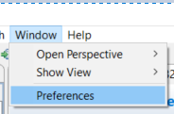
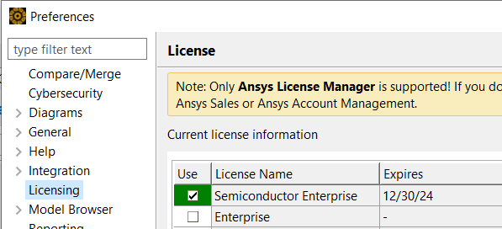
Licensing Requirements
The licensing requirements:
  The license required for safety analysis updates is “Enterprise or Premium”
  Process to select the license is shown below:
    Window -> Preferences -> Licensing

Slide 6
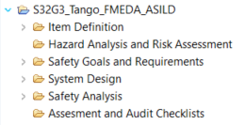
NXP Medini FMEDA Structure (1/3)
FMEDA consist of multiple packages as shown in image:
  Item Definition
  HARA
  Safety goal and requirements
  System Design
  Safety Analysis
  Assessment and Audit Checklists
An example Figure from S32G Family of devices

Slide 7
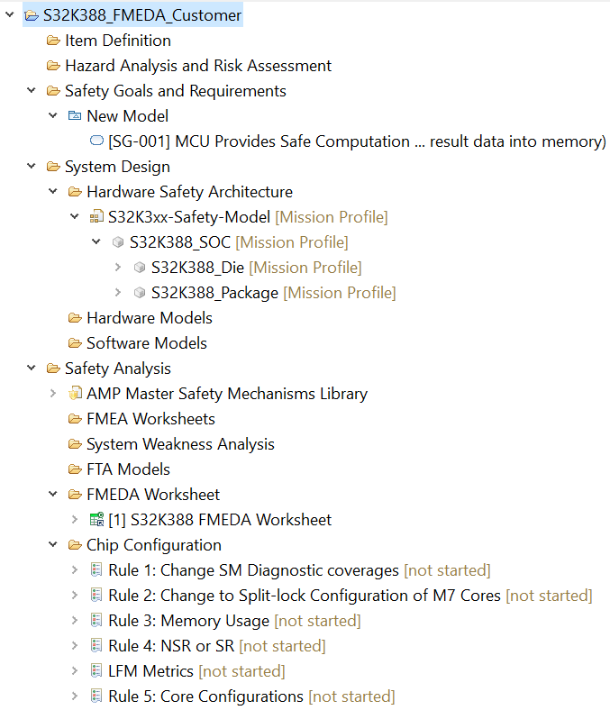
NXP Medini FMEDA Structure (2/3)
Each package has multiple sub-packages/features as highlighted in “red”
NXP uses different features of the tool on need basis such as:
  Safety goal (ASIL D, ASIL B) (Recommend Not to edit)
  Safety mechanism library (Recommend Not to edit)
  Hardware safety architecture (Recommend Not to edit)
  FMEDA worksheet (Acceptable to edit)
  Chip configuration (Acceptable to edit)
Please note:
  NXP does not recommend to edit any NXP defined packages or library in the shared medini project.
  Acceptable to edit means customer can edit specified worksheet or checklist.
Represent FMEDA worksheet
DC Configurator rules

Slide 8
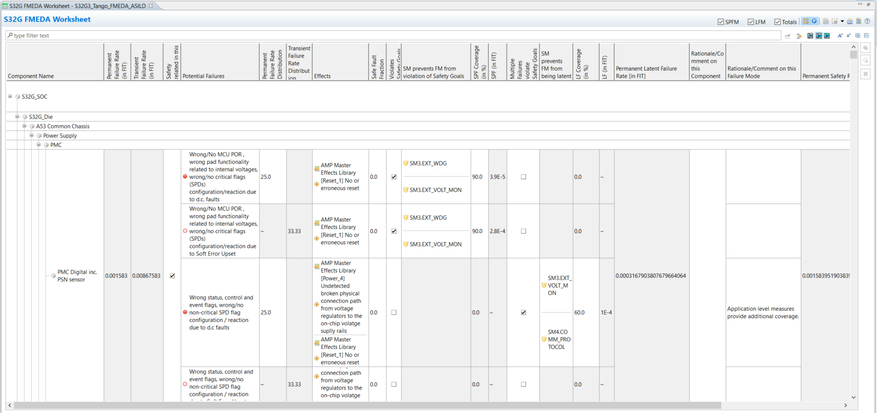
NXP Medini FMEDA Structure (3/3)
SPF Safety goal violation
Safety mechanism preventing SPF violation
Failure mode
Transient Failure rate distribution
Safety related
Safety mechanism preventing MPF violation
IP module
Permanent Failure rate distribution
MPF Safety goal violation

Slide 9
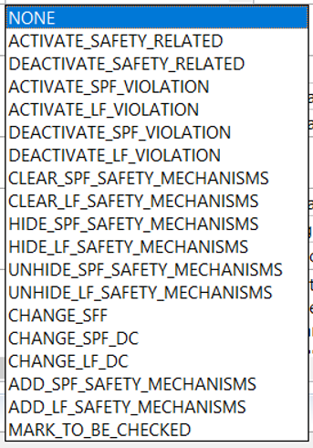
Medini FMEDA customization Approach
The NXP provides 2 approaches for FMEDA customization:
  DC Configurator approach
  Direct updates in FMEDA DC worksheet
The 1st preferred approach for FMEDA customization is DC Configurator approach and NXP provided different rules as shown in image.
Customer can select appropriate rule and customize the FMEDA worksheet. If provided DC rule isn’t sufficient then customer can use 2nd approach.
  Note: NXP review only includes changes made with DC configurator script.
Slides attached shows how to select and execute the DC Configurator rule.

Slide 10
Medini FMEDA customization support
The customization supported by NXP in medini FMEDA are:
  Change the Mission profile and recomputing failure rate
  Change the catalog to SN-29500
  Change of SM3, SM4 safety mechanism
  Change IP module as SR/NSR
  Adding customers customized safety mechanism
  Changing diagnostic coverage (DC) of safety mechanism
  Changing SPF violation
  Changing MPF violation
  Changing safe fault fraction

Slide 11
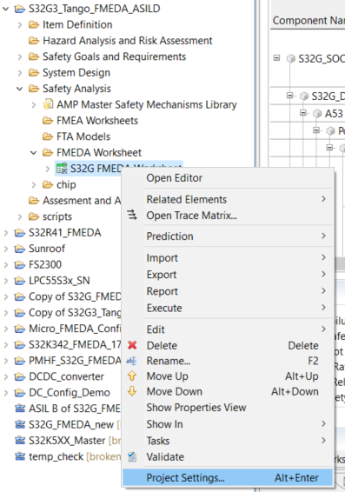
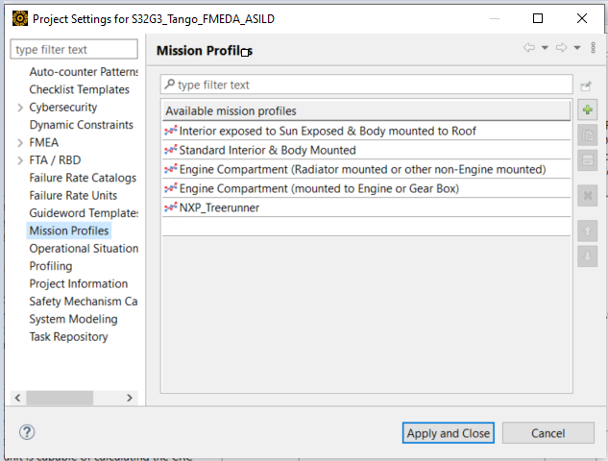
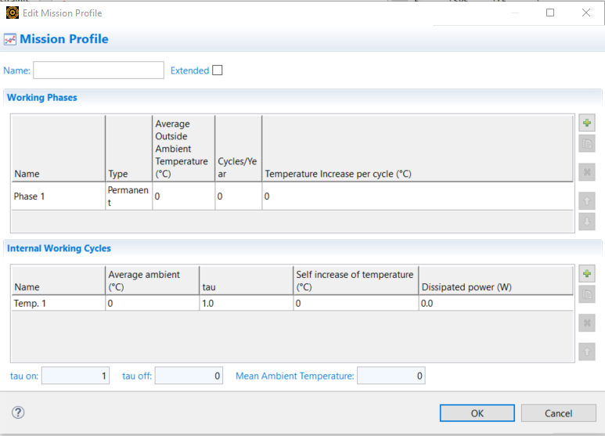
Adding Mission Profile in MEdini
Customer can change the mission profile based on use-case of the application.
The method to change the mission profile is as follows:
  Right click on “project name” as shown in image
  Go to “Project settings”
  Project setting pop up window will open as shown in image.
  Click on “Mission profile”
  Click on Plus icon as shown in image.
  Edit mission profile window will open.
  Customer can enter mission profile details
  Click on “Ok” then “Apply and clock”

Slide 12
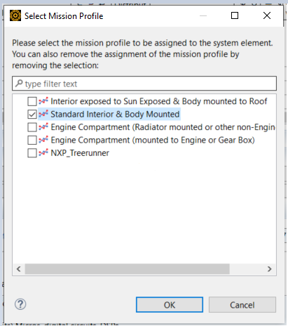
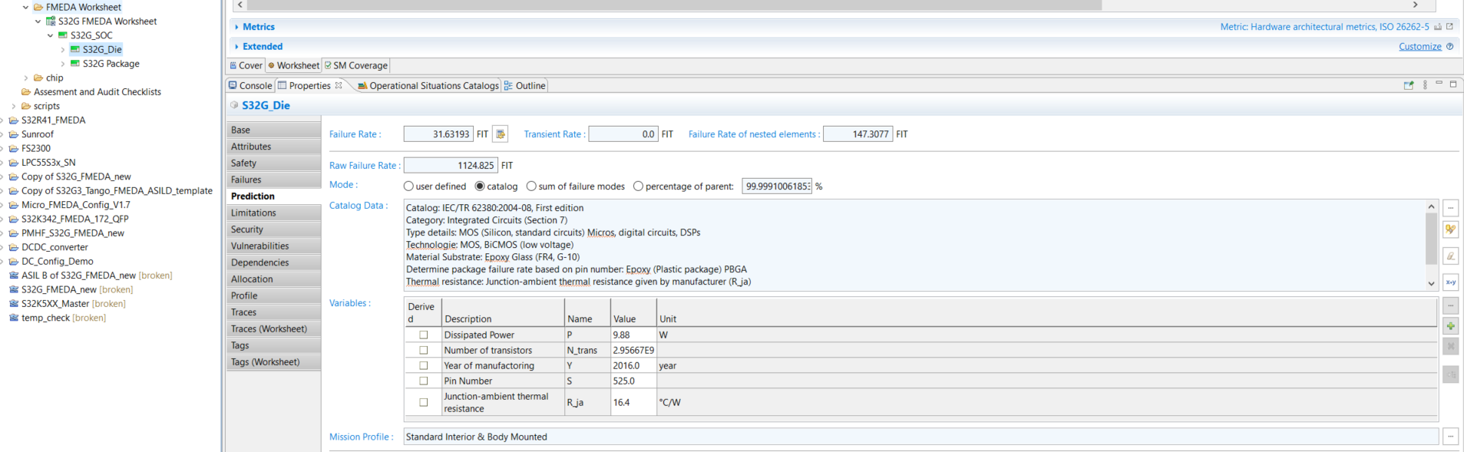
Updating Mission Profile in Medini (1/2)
Once the mission profile is added as shown in previous slides.
Follow the “red boxes” path as shown in below image.
  Click on “S32G_Die” -> Go to “Properties” -> Click on “Prediction” -> click on three dots “…”
  After clicking on the below 3 dots.
  Select Mission profile window open as shown in the image.
  Select the added the mission profile and click on “Ok”
Please note: Same procedure to be followed as “S32G Package” level and update the mission profile at “S32G Package”. The subsequent slides shows the mission profile at S32G Package level.

Slide 13
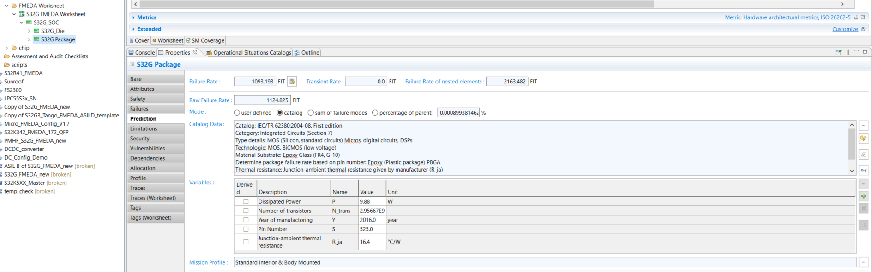
Updating Mission Profile in Medini (2/2)
Once mission profile is updated at “S32G_die” and “S32G Package” level
Then click on recompute failure rate option as shown below.
Recompute failure rate

Slide 14
Changing catalog from iec tr 62380 to sn-29500
By default, NXP uses IEC TR 62380 catalog for the FIT calculation of SoC.
If customer want to switch this to SN 29500 based calculation, then they need to follow the steps mentioned in the file below:
Notes:
Note: What would be nxp recommendation if customer uses mission profile or sn norm catalog due to which Metrics are not met.? Please add note supporting these comment.

Slide 15
Working with DC Worksheet – Structure
The NXP follows below naming convention for safety mechanisms:
  SM1: Hardware safety mechanism within the chip, implemented by NXP
  SM2: Software safety mechanism within the chip, implemented by NXP
  SM3: Off-chip hardware safety mechanism, to be implemented by the system developer
  SM4: Software safety mechanism, to be implemented by the system developer
Customer has the option to change the safety mechanism for single point fault (SPF) and Multi-point fault as per the use-case application.
The changes of SM1 and SM2 safety mechanism are prohibited, as they mandatory for meeting the SPFM and LFM metrics. SM3 and SM4 safety mechanism diagnostic coverage can be configured based on customers use-case application.
SM3 and SM4 safety can be removed if not relevant for customers use-case application provided the SoC AoUs and metrics are met.
Customer can add their customized safety mechanism in the safety mechanism library and then can add it into FMEDA worksheet.
Method of adding safety mechanism is shown in following slides.

Slide 16
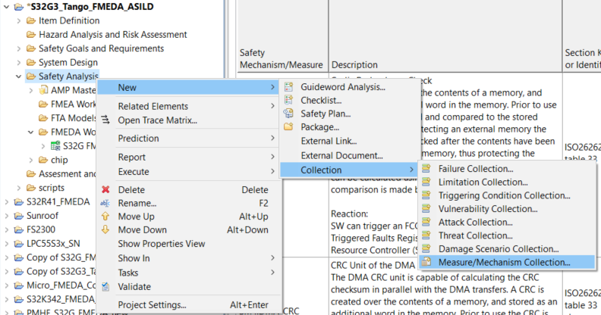
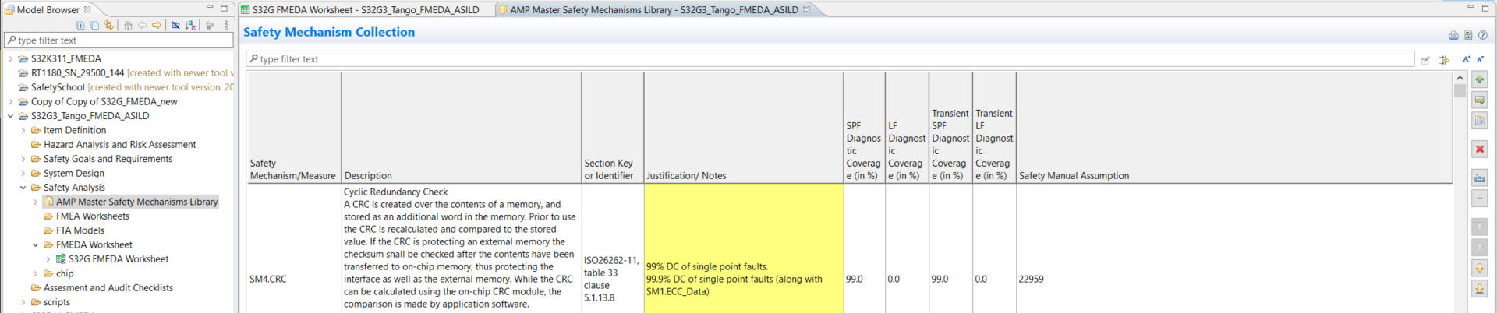
Adding customer Safety mechanism in sM Library
As shown in image towards right.
  Right click on Safety analysis -> New -> Collection -> Measure/Mechanism Collection
Then New safety mechanism library will be created inside the model browser project area
Double click on safety mechanism library in module browser.
The safety mechanism library window will open.
Click on plus option as shown in the 2nd image.
Customer can refer the NXPs “AMP Master Safety mechanism library” and customer can create their own Safety mechanism library as mentioned above.

Slide 17
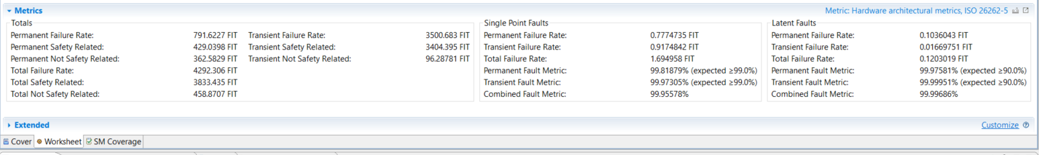
Interpretation of FMEDA results
FMEDA results for metric can be seen inside “Metrics” tab under “Worksheet”.
The image below shows the Metric summary:
  Permanent failure rate
  Transient failure rate
  Single point fault metric (SPFM)
  Latent fault metric (LFM)
The SPFM and LFM are shown separately and combined for Permanent and transient as per the ASIL targets. This can be used to evaluate if the metrics have met target or not.

Slide 18
Customer FMEDA Review
Once the customization is completed for FMEDA, the customer need to send back the FMEDA to NXP for the review.
Below are the two ways to share back the FMEDA project for review:
  The review can be facilitated by the Field Application Engineer assigned to the customer and the FAE raise a ticket on safe assure page for review.
  Or the customer raises a service now ticket for the review https://support.nxp.com/ (Specify Safe Assure/ FMEDA customization in the title for faster answer).
Customized FMEDA will be shared to the Functional safety expert at NXP to check the consistency of the FMEDA changes and generate the review checklist reports.
This review may take a lead time of about 2 to 3 weeks depending on the availability of the safety expert.
Once the review is complete, the updated FMEDA and the review checklist reports will be then made available to customer via Doc store.
Share issue or feedback on NXP SafeAssure Community if you see some issues or improvement we could made.

Slide 19
Appendix for Using DC Configurator

Slide 20
Purpose of Dc Configurator
To enable customer to configure the Medini FMEDA as per use-case application.
Customer to modify Medini FMEDA worksheet via DC checklist
To enable limited modifications in FMEDA as per module classification sheets
To allow customer to add mission profile independently via DC Configurator licenses

Slide 21
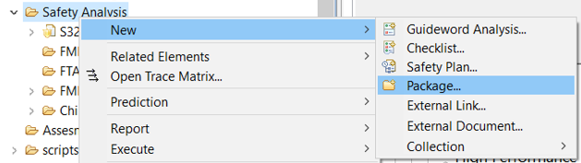

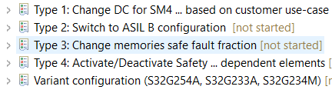
How to set-up Dc Configurator checklist
Customer need to create new “Package” (for example: Chip configuration) by clicking on “Safety analysis -> New -> Package” as shown below:
Once Package is created. The checklist need to be created by clicking on “Chip configuration -> New -> Checklist” as shown below:
Customer can create different checklist as per configuration required in FMEDA

Slide 22
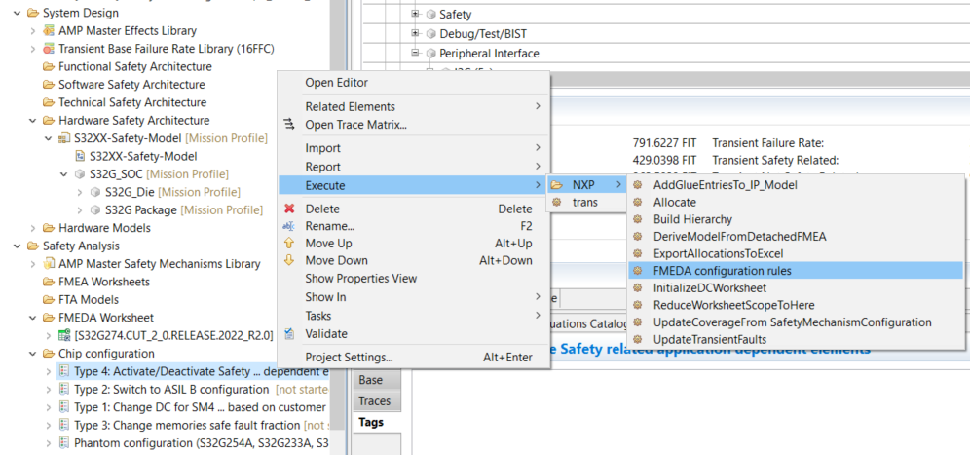
Executing DC CONFIGURATOR Rules
The procedure to execute the DC Configurator rule is shown below:
Click on “Checklist” -> Go to “Execute” -> “NXP” -> “FMEDA configuration rules”

Slide 23
Rule type
There are multiple rule available to configure the Medini FMEDA worksheet as shown below:
The guidelines on how to apply the above DC rules are available slide x onwards.

Slide 24
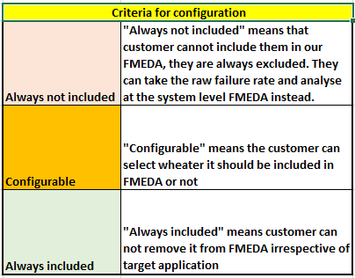
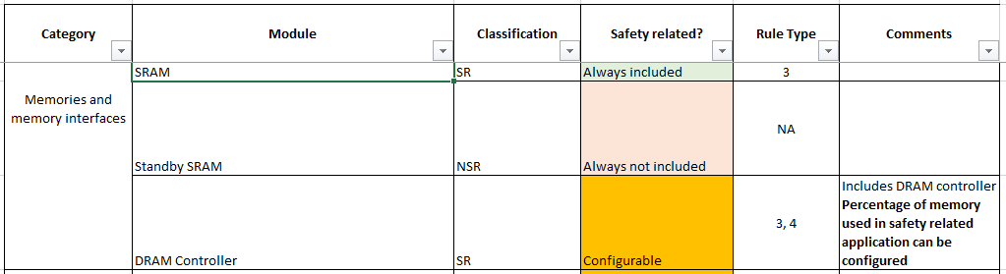
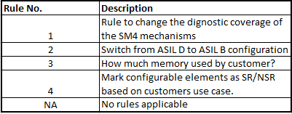
Prerequisite of Dc Configurator
Customer can configure FMEDA using rule type mentioned in module configurability sheet.
The S32G2 module configurability sheet is attached as references.
The criteria for configuration are divided into 3 subsection as shown below:
  Always not included
  Configurable
  Always included
The configuration criteria is decided for all the IPs in the module configurability sheet.
Different rule types are mentioned against each IP.

Slide 25
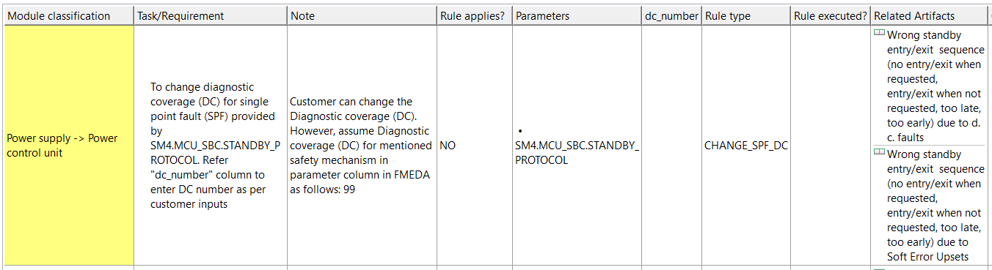
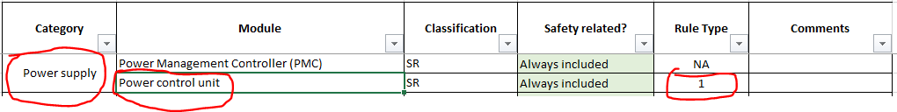
Mapping Module Configurability with Medini Checklist
The below example shows the SPF DC change and Module configurability excel sheet mapping medini checklist.
Rule type: Change SPF DC
The column ordering should be as shown below:
  Module classification: It is used to provide mapping between Module configurability and Medini Checklist.
  Task/Requirements: To provide guide to change diagnostic coverage for safety mechanism.
  Note: It provides information regarding DC claimed in FMEDA.
  Rule applies: Status on rule is applied or not.
  Parameters: Information related to which safety mechanism DC is changed.
  Rule type: mentions which type is applied (for e.g. CHANGE_SPF_DC)
  Rule executed: information related whether rule is executed or not.
  Related Artifacts: provides information on which artifact the rule should be executed.
IN REVIEW

Slide 26
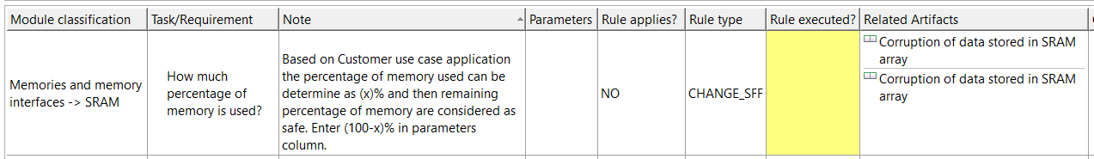
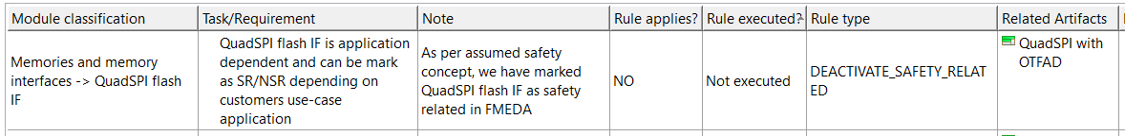
Mapping Module Configurability with Medini Checklist
Rule type: Change SFF
The column ordering should be as shown below:
Rule type: Deactivate safety related
The column ordering should be as shown below:
IN REVIEW

Slide 27
How to use DC Rule
Activate_Safety_Related: Use to activate specific IP of FMEDA as safety related if marked as non safety related in FMEDA.
  Related Artifacts: Components name (For e.g: HPBG) or Failure Mode entry
Deactivate_Safety_Related: Use to deactivate specific IP of FMEDA as non safety related if marked as safety related in FMEDA.
  Related Artifacts: Components name (For e.g: HPBG) or Failure Mode entry
Activate_SPF_Violation: Use to activate specific failure mode of FMEDA for SPF if unticked in FMEDA.
  Related Artifacts: Failure Mode entry
Deactivate_SPF_Violation: Use to deactivate specific failure mode of FMEDA for SPF if ticked in FMEDA.
  Related Artifacts: Failure Mode entry
*SPF: Single Point Fault
IN REVIEW

Slide 28
How to use DC Rule
Activate_LF_Violation: Use to activate specific failure mode of FMEDA for LF if unticked in FMEDA.
  Related Artifacts: Failure Mode entry
Deactivate_LF_Violation: Use to deactivate specific failure mode of FMEDA for LF if ticked in FMEDA.
  Related Artifacts: Failure Mode entry
Clear_SPF_Safety_Mechanisms: Use to clear SM with DC=0 of specific failure mode in FMEDA for SPF column.
  Related Artifacts: Failure Mode entry
Clear_LF_Safety_Mechanisms: Use to clear SM with DC=0 of specific failure mode in FMEDA for LF column.
  Related Artifacts: Failure Mode entry
*SM: Safety Mechanism
*SPF: Single Point Fault
*LF: Latent Fault
IN REVIEW

Slide 29
How to use DC Rule
Hide_SPF_Safety_Mechanisms: Use to Hide SM of specific failure mode in FMEDA.
  Related Artifacts: Failure Mode entry
  Parameters: Safety Mechanism name
  dc_number: Enter diagnostic coverage (DC)
Hide_LF_Safety_Mechanisms: Use to Hide SM of specific failure mode in FMEDA.
  Related Artifacts: Failure Mode entry
  Parameters: Safety Mechanism name
  dc_number: Enter diagnostic coverage (DC)
Unhide_SPF_Safety_Mechanisms: Use to Unhide SM of specific failure mode in FMEDA.
  Related Artifacts: Failure Mode entry
  Parameters: Safety Mechanism name
  dc_number: Enter diagnostic coverage (DC)
Unhide_LF_Safety_Mechanisms: Use to Unhide SM of specific failure mode in FMEDA.
  Related Artifacts: Failure Mode entry
  Parameters: Safety Mechanism name
  dc_number: Enter diagnostic coverage (DC)
IN REVIEW

Slide 30
How to use DC Rule
Change_SFF: Use to change SFF portion of specific failure mode in FMEDA.
  Related Artifacts: Failure Mode entry
  Parameters: SFF value
Change_SPF_DC: Use to change SPF DC for specific failure mode in FMEDA.
  Related Artifacts: Failure Mode entry
  DC Values: Enter diagnostic coverage (DC)
Change_LF_DC: Use to change LF DC for specific failure mode in FMEDA.
  Related Artifacts: Failure Mode entry
  DC Values: Enter diagnostic coverage (DC)
*SFF: Safe Fault Fraction
*SPF: Single Point Fault
*LF: Latent Fault
IN REVIEW

Slide 31
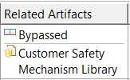
How to use DC Rule
Add_SPF_Safety_Mechanisms: Use to add customer SMs for specific failure mode in FMEDA for SPF section.
  Related Artifacts: Failure Mode entry and Safety Mechanism Library (Refer note)
  Parameters: SM name
  DC Values: Enter diagnostic coverage (DC)
Add_LF_Safety_Mechanisms: Use to add customer SMs for specific failure mode in FMEDA for LF section.
  Related Artifacts: Failure Mode entry and Safety Mechanism Library (Refer note)
  Parameters: SM name
  DC Values: Enter diagnostic coverage (DC)
Note: The Customer Safety mechanism shall be added in default library created by FSA or Customer named as “Customer Safety mechanism Library” which goes as input to related artifact column as shown below.
*SM: Safety Mechanism
IN REVIEW

